Slide 1
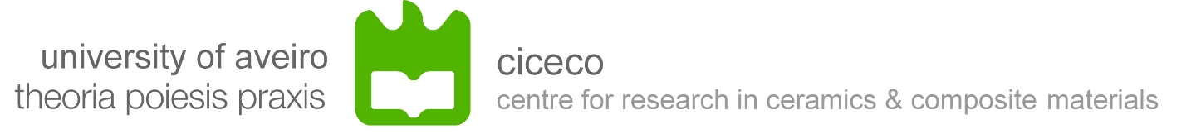
THE SEPARATION OF ANODIC AND CATHODIC DEFECTS ON ORGANIC COATINGS
AETOC2015
La Rochelle, France
22-25 Abril 2015
A.C. Bastos, M.C. Quevedo, M.G.S. Ferreira

Slide 2
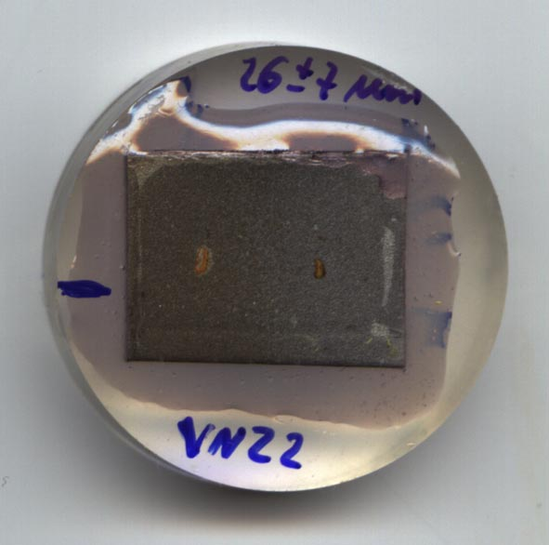
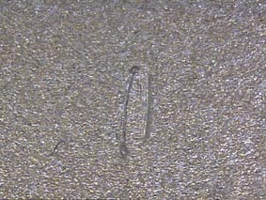
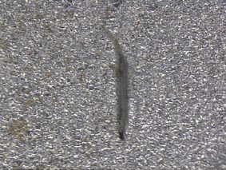
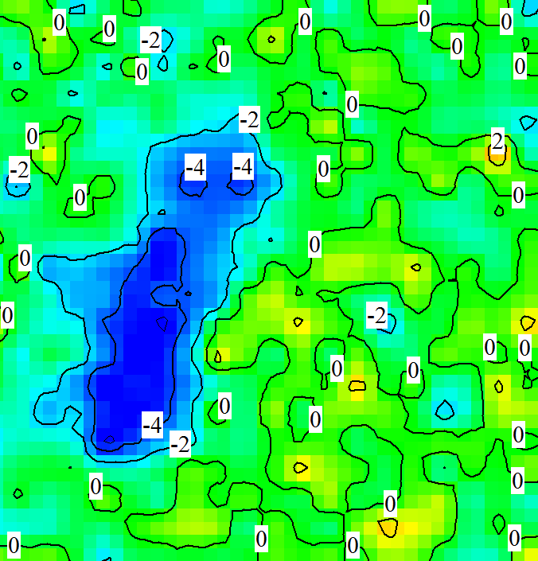
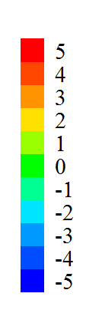
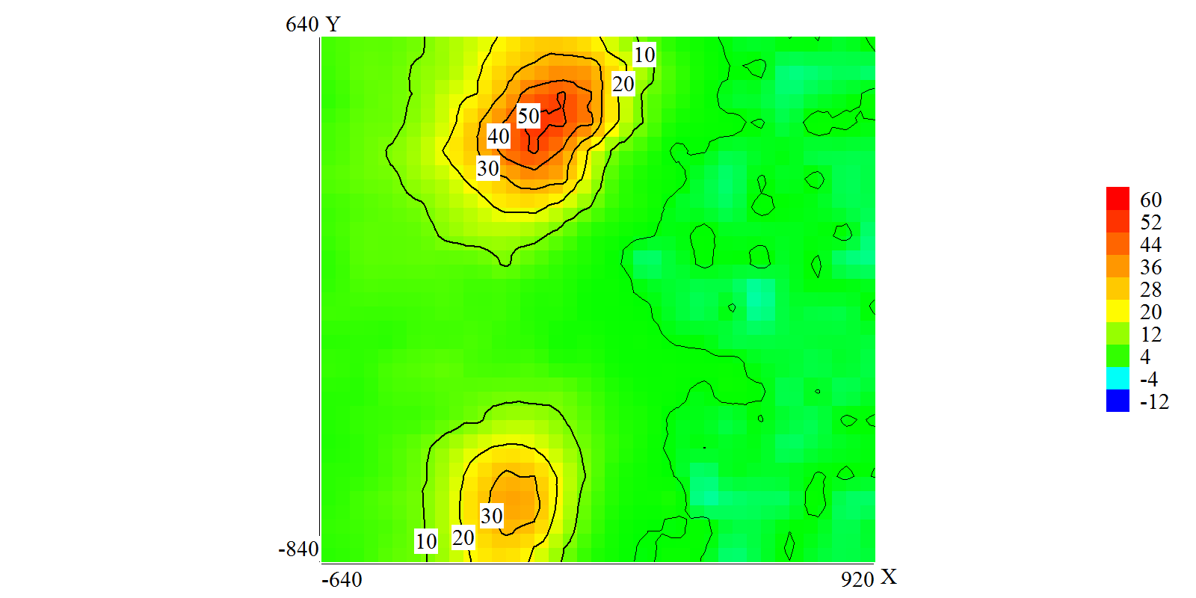
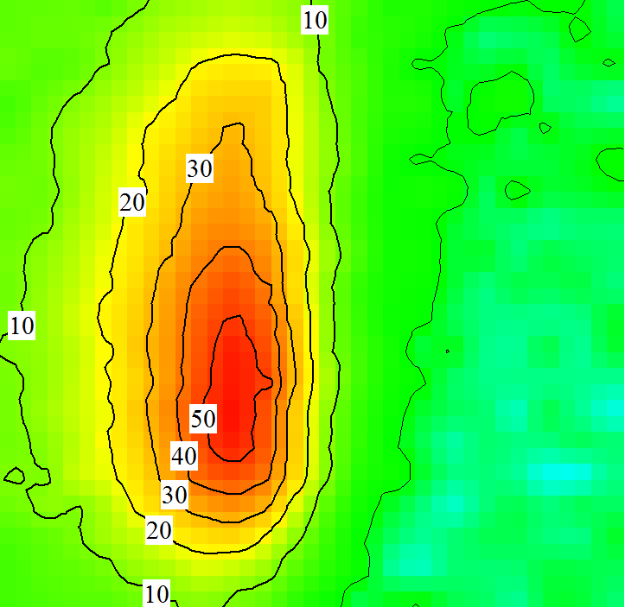
Context
Epoxy clearcoat on carbon steel; 0.1M NaCl
8.5mm
1mm
1mm
10 minutes
25 min
1 hour
3.3
μA cm⁻²
1.4
1.4
μA cm⁻²
0.7
Y / mm
Y / mm
1.65
0.7
Y / mm
0
0
0.75
1.5
0
0.75
0
X / mm
0
X / mm
1.5
0
1.6
3.2
X / mm

Slide 3
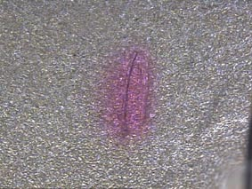
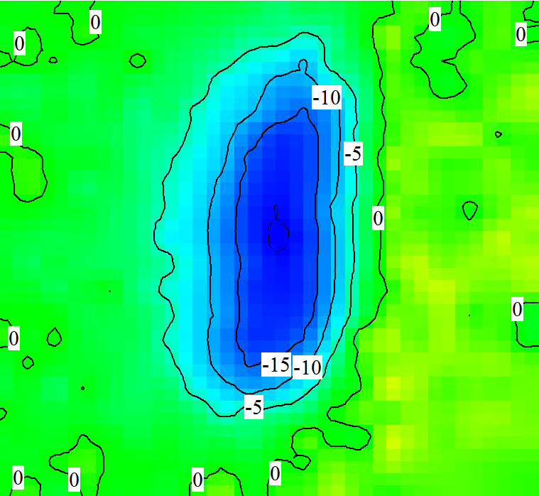
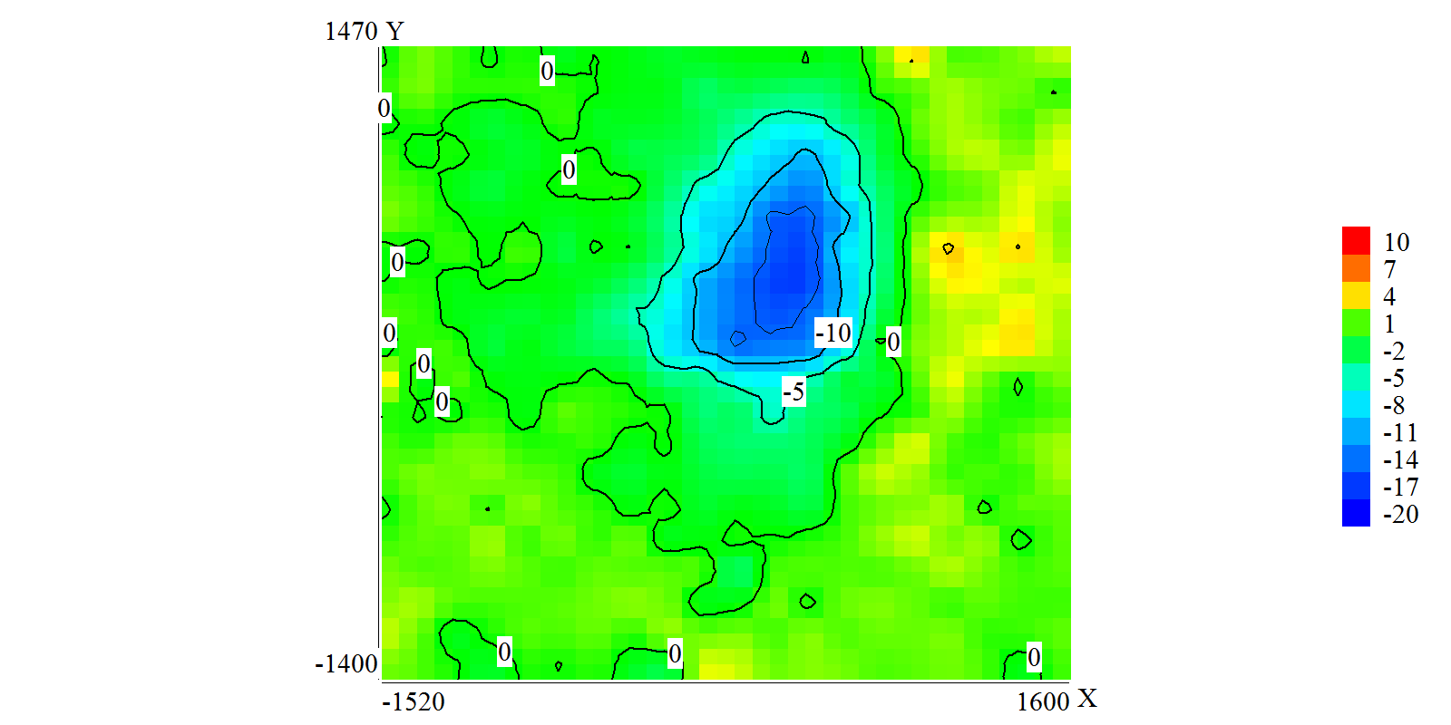
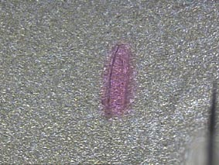
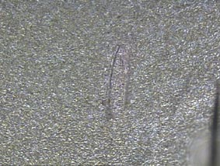
phenolftalein
2.8
μA cm⁻²
1.4
Y / mm
1mm
0
0
1.55
3.1
X / mm
beginning
2.8
Scan starts with both defects exposed.
At the middle of the scan (point 200 in a map of 20x20 points) the anodic defect was covered. Cathodic activity immediately disappeared.
1.4
end
Y / mm
0
0
1.55
3.1
X / mm

Slide 4
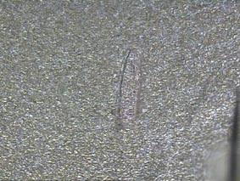
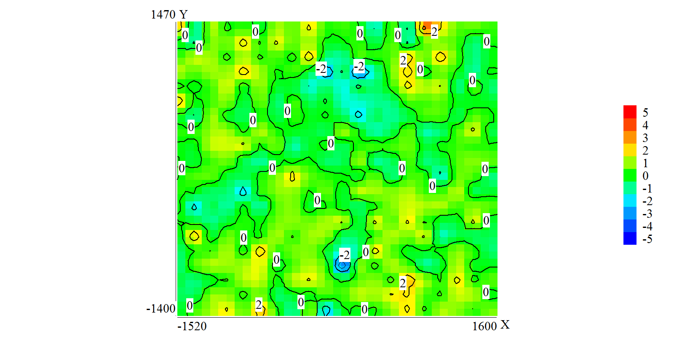
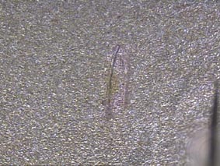
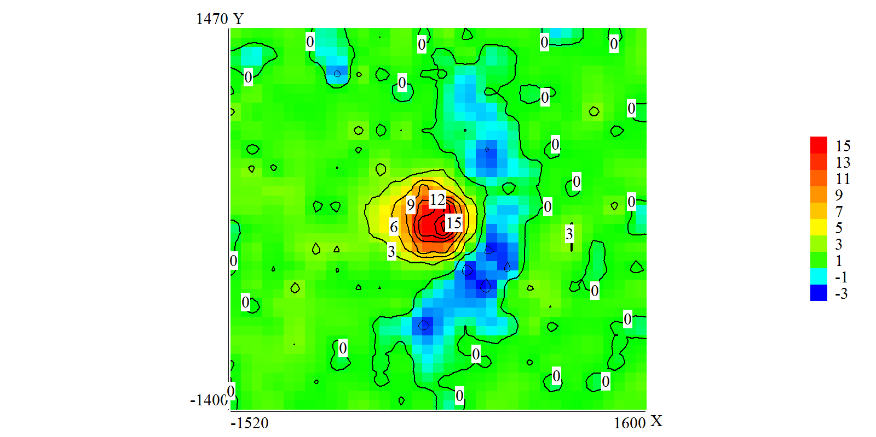
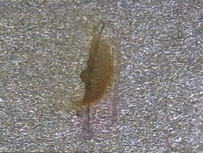
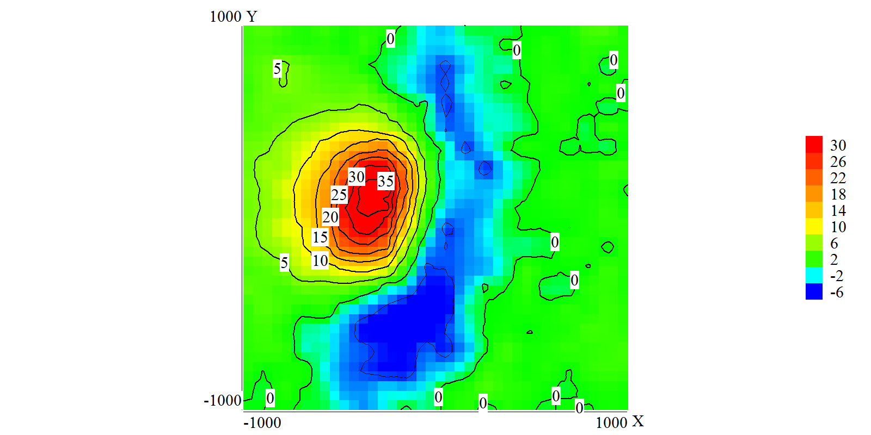
2.8
μA cm⁻²
10 minutes after separation
1.4
1mm
0
0
1.55
3.1
2.8
μA cm⁻²
1.4
50 min
Y / mm
1mm
0
0
1.55
3.1
2
μA cm⁻²
3h40
1
1mm
0
0
1
2
X / mm

Slide 5
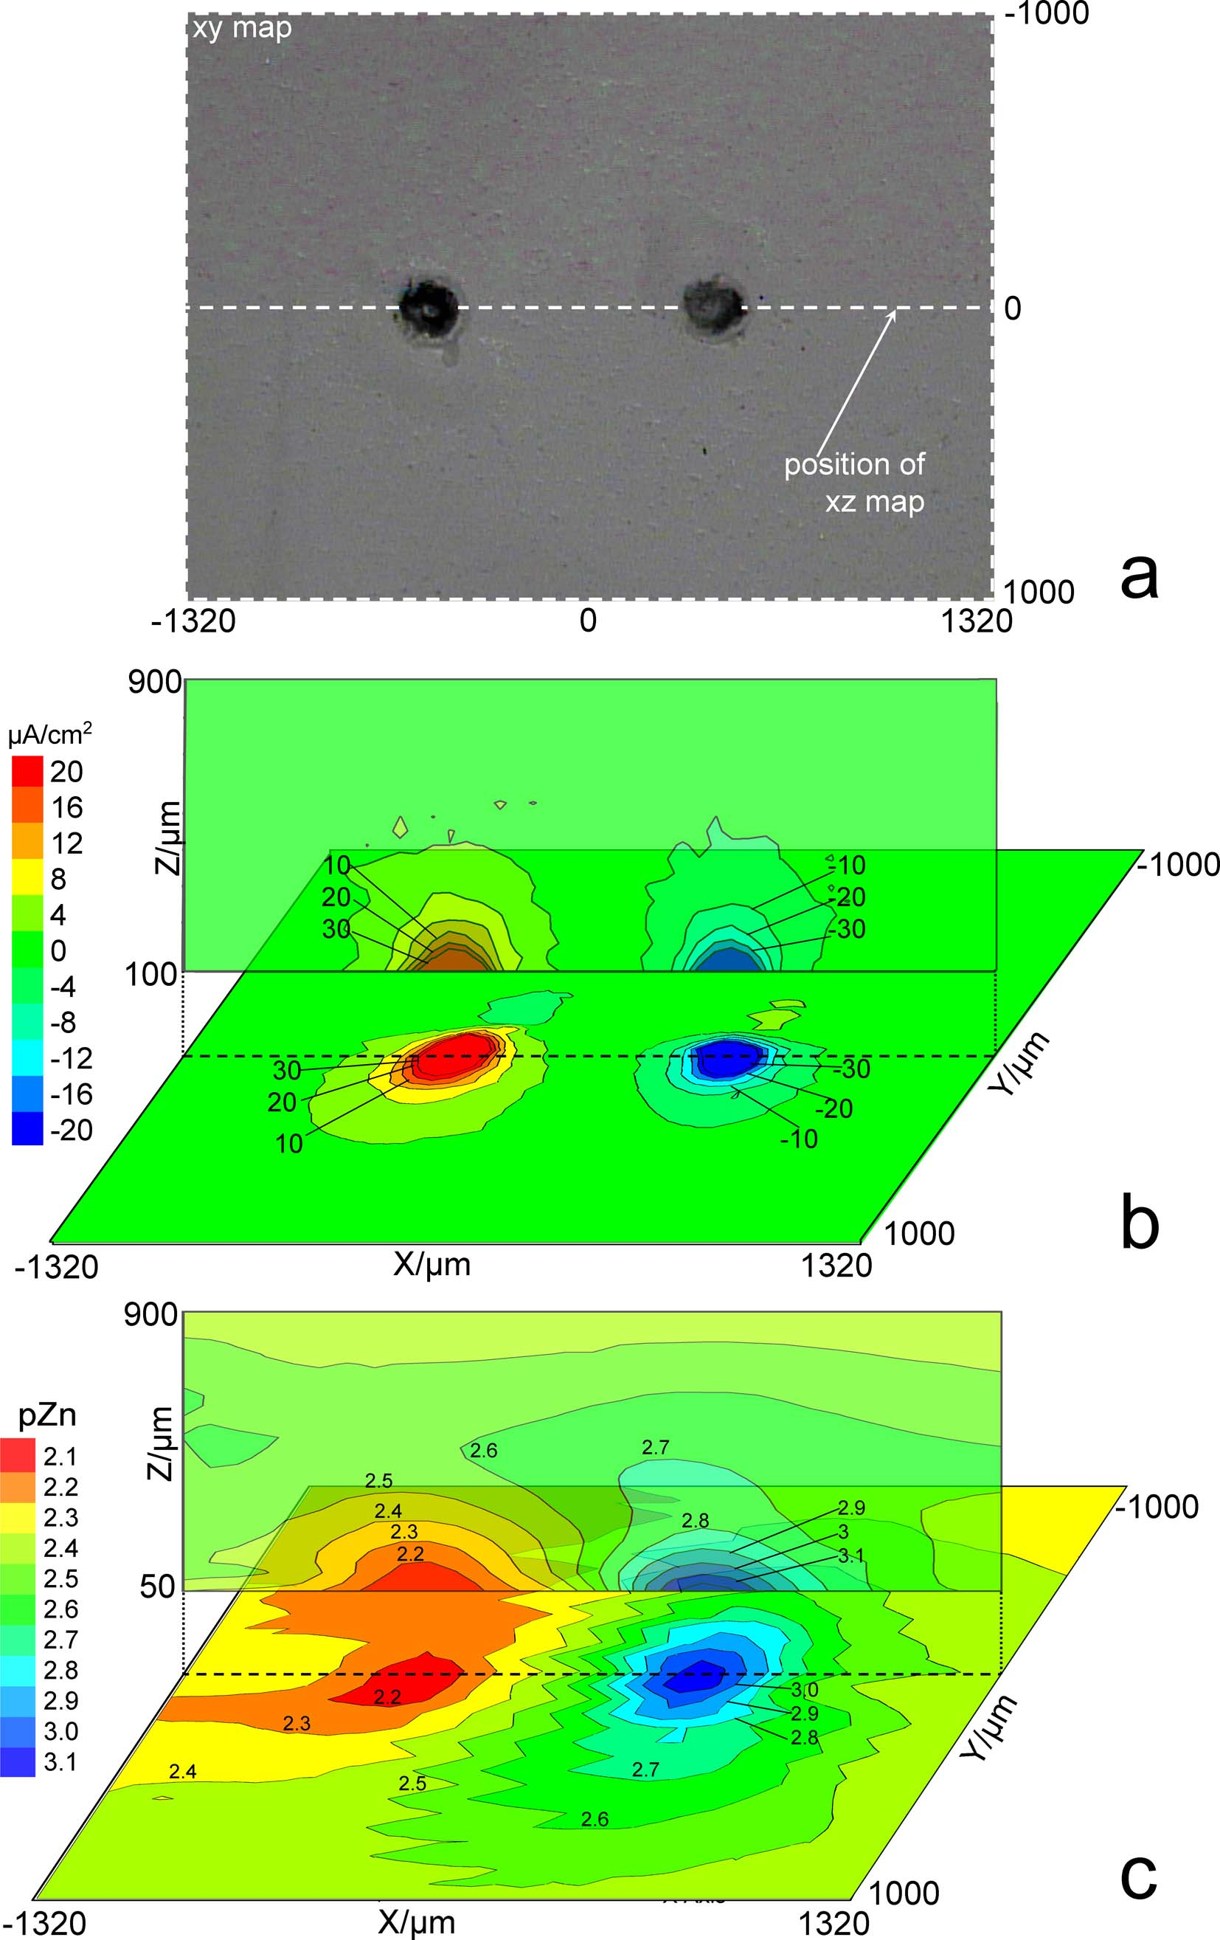
More examples…
Painted HDG
(SVET, Zn²⁺)
Electrochem. Commun. 12 (2010) 394

Slide 6
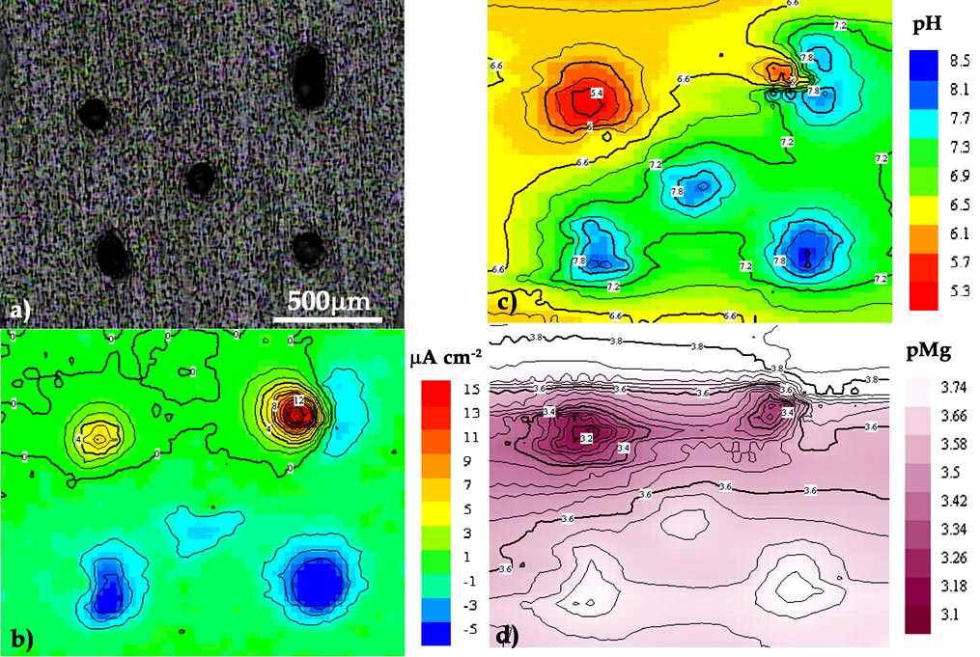
More examples…
Sol-gel coated AZ31 magnesium alloy
(SVET, pH, Mg²⁺)
Electrochem. Commun. 10 (2008) 259

Slide 7
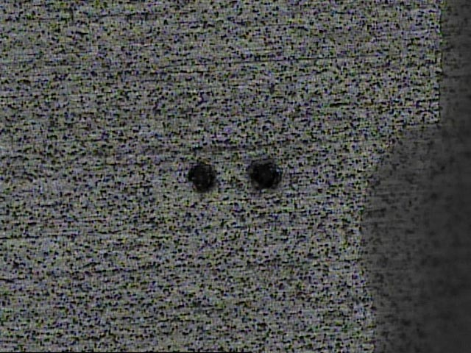
More examples…
Sol-gel coated 2024 aluminium alloy
(SVET, pH, O₂)
19 hours in
0.05 M NaCl
5 µA cm⁻²
500 µm
Electroanalysis 22 (2010) 2009

Slide 8
More examples…
Sol-gel coated 2024 aluminium alloy
(SVET, pH, O₂)
Electroanalysis 22 (2010) 2009
lines
500 µm

Slide 9
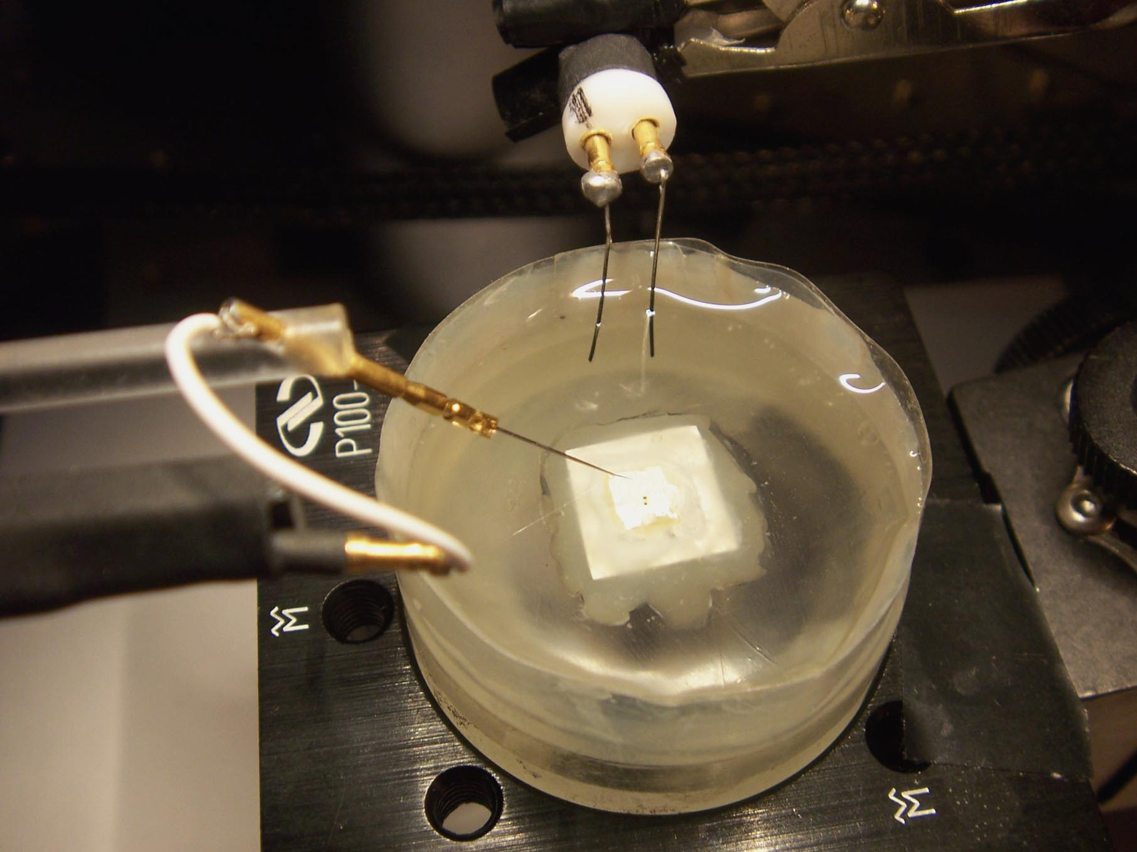
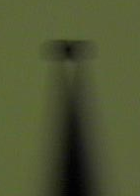
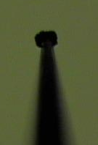
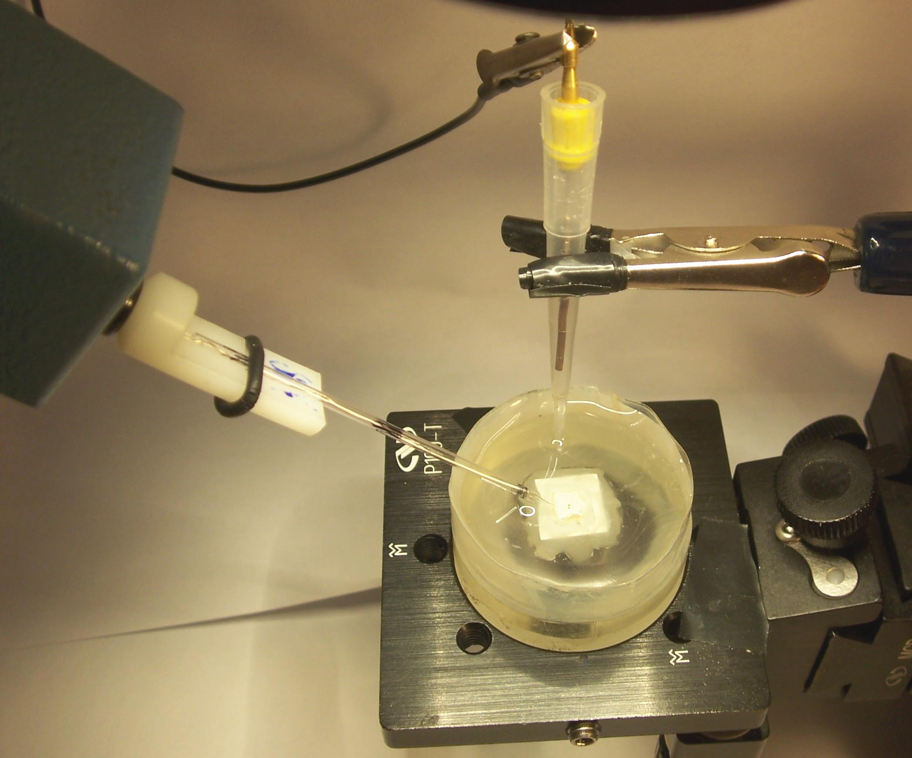
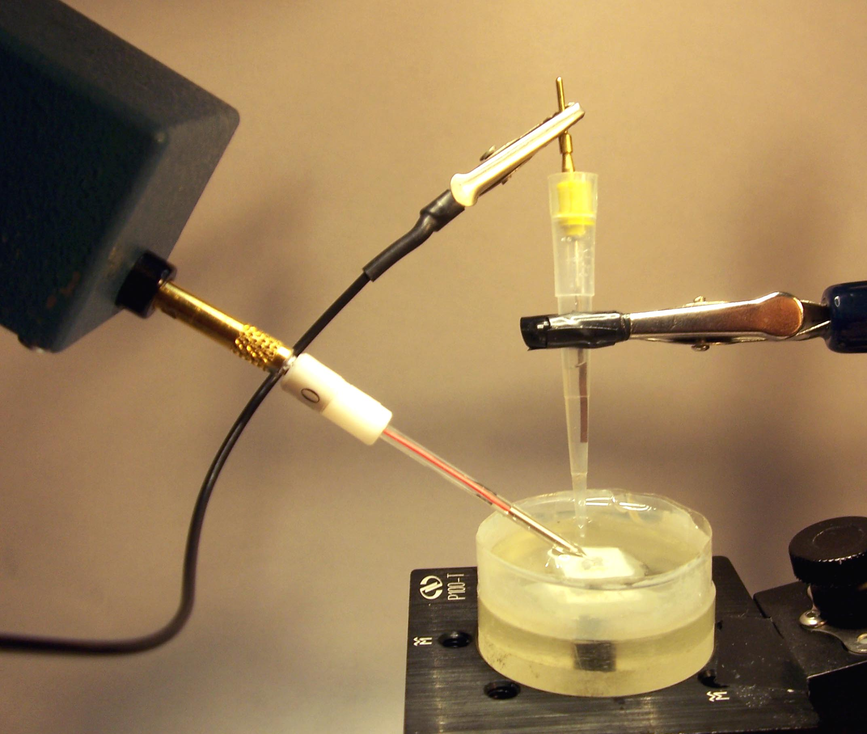
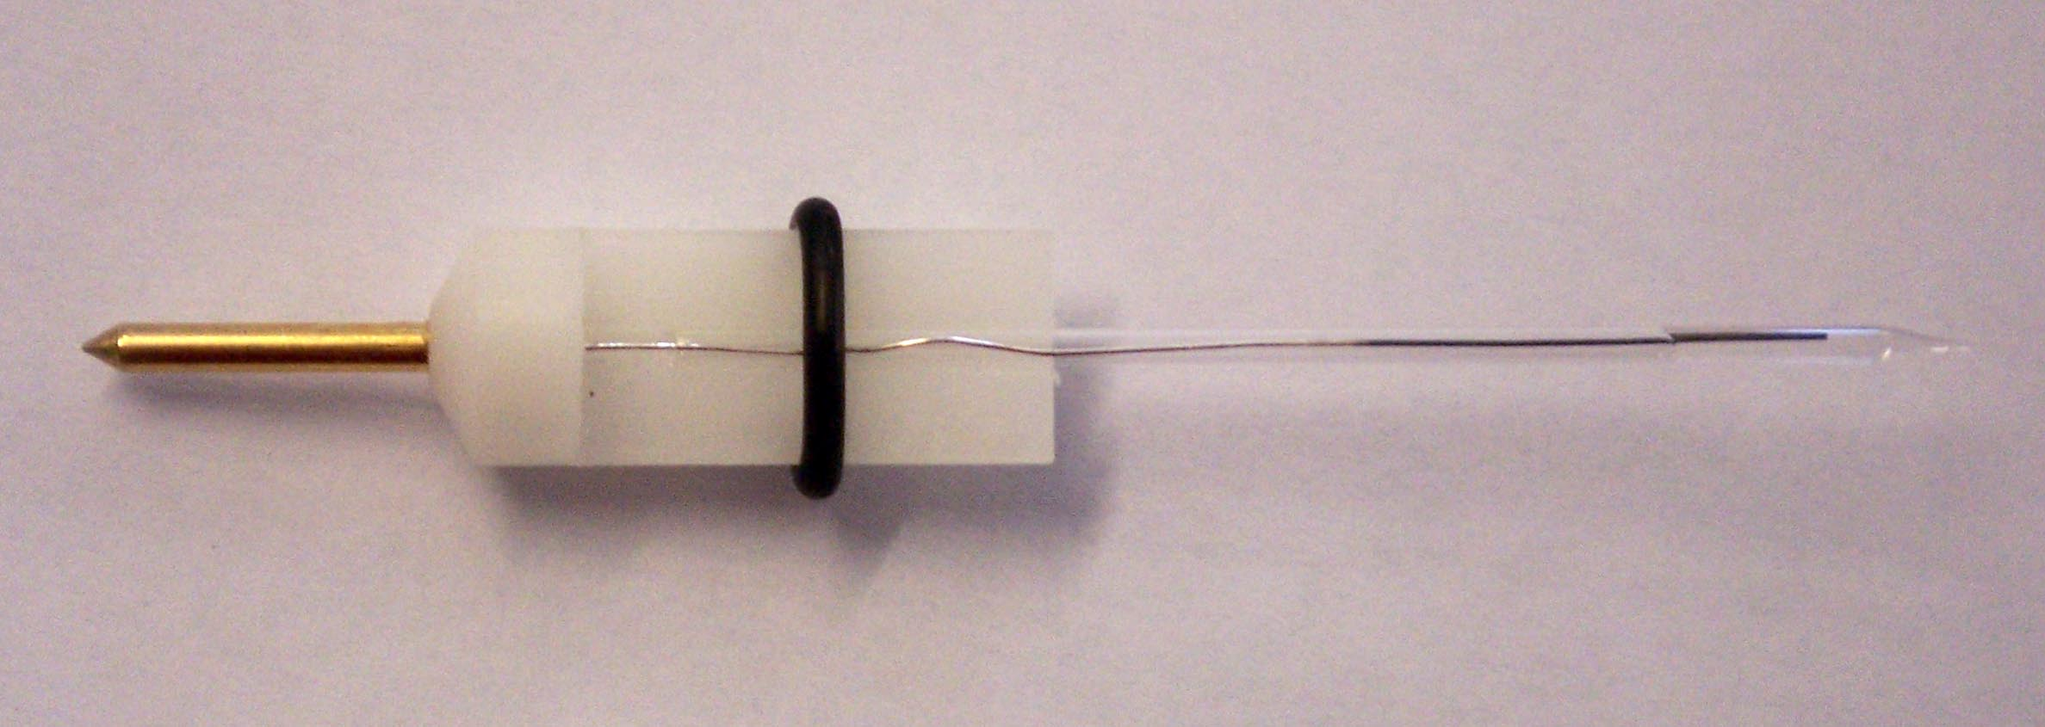
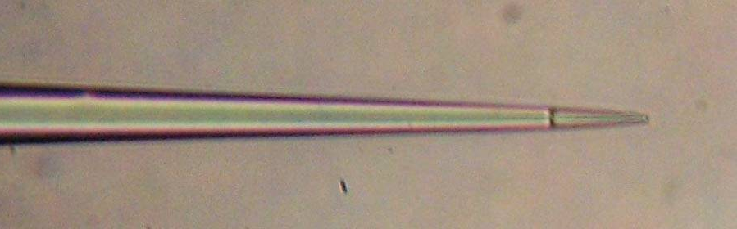
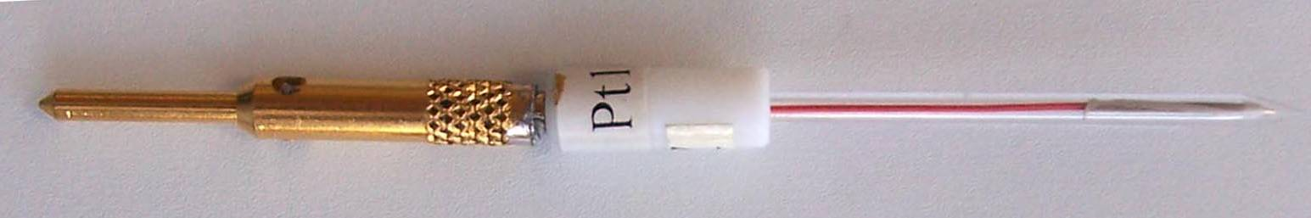
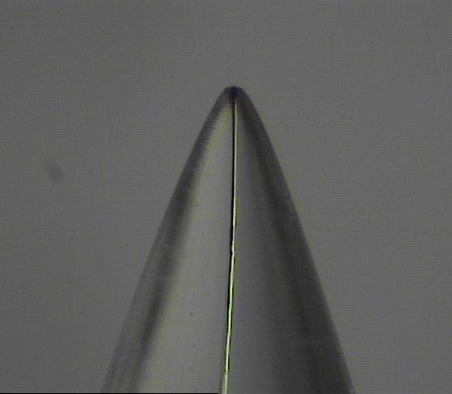
The techniques
Scanning Vibrating Electrode Technique
vibrating
probe
Ground and pseudo
reference
electrode
Micro-potentiometry (pH)
10 μm
Potentiometric response with commercial pH buffers.
RE
vibrating
probe
ISME
Micro-amperometry (O₂)
1 cm
sample
r²=0.997
Voltammogram for the reduction of dissolved oxygen in 0.05M NaCl
Ag wire with AgCl coat
glass micropipette
pH sensitive ionophore FLUKA ref. 95293
pre-amplifier
head
reference
electrode
Filling solution:
0.1M KCl + 0.01M KH₂PO₄
25 µm
1 cm
region of diffusion
control
platinum
microdisc
electrode
10 µm Pt wire

Slide 10
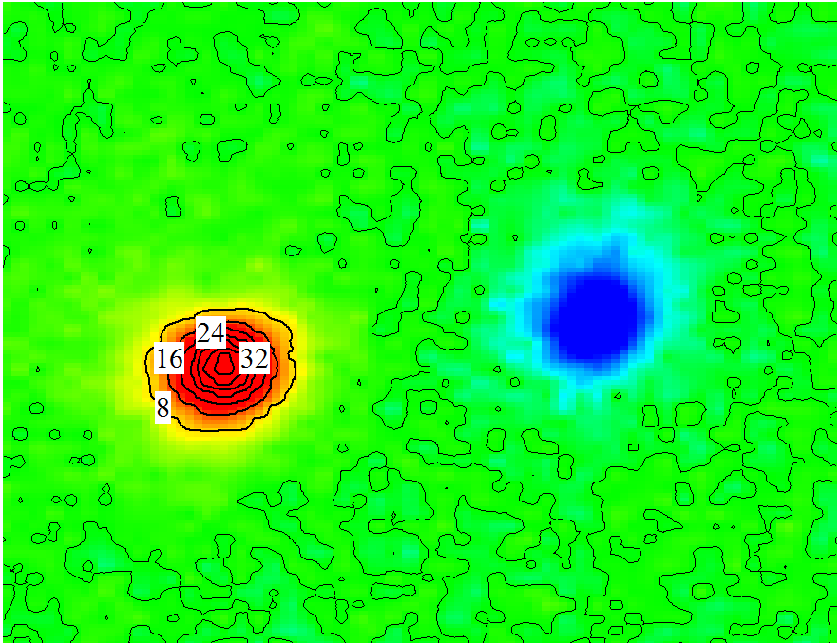
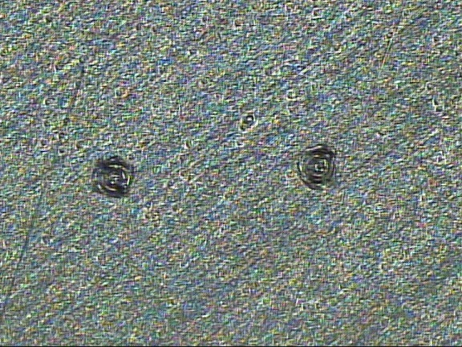
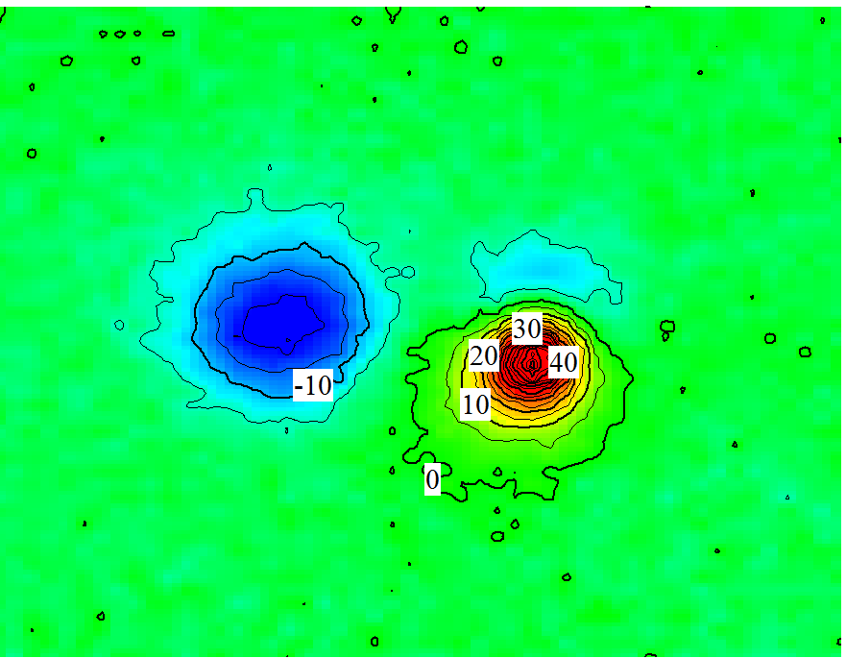
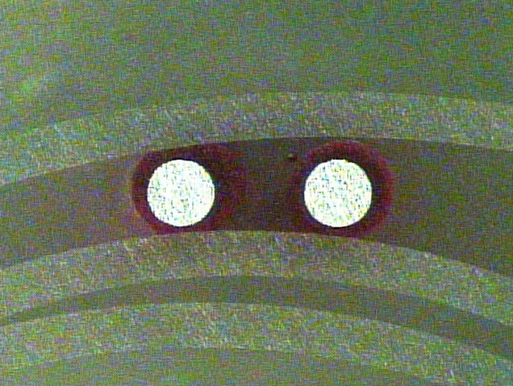
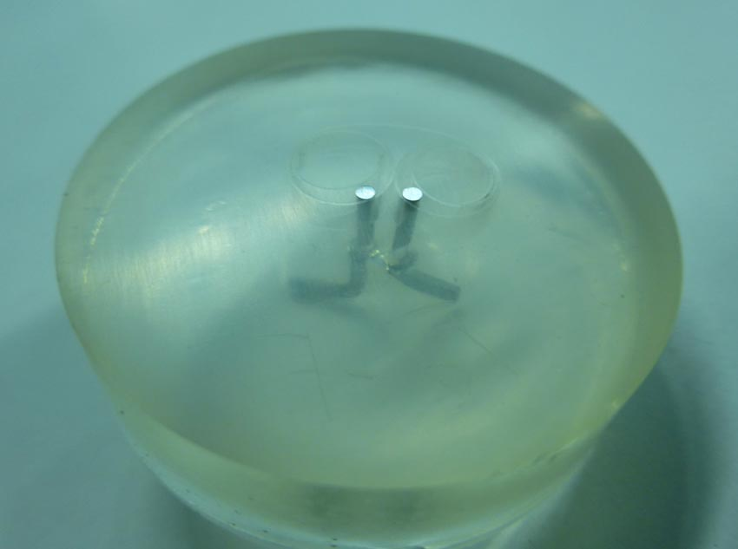
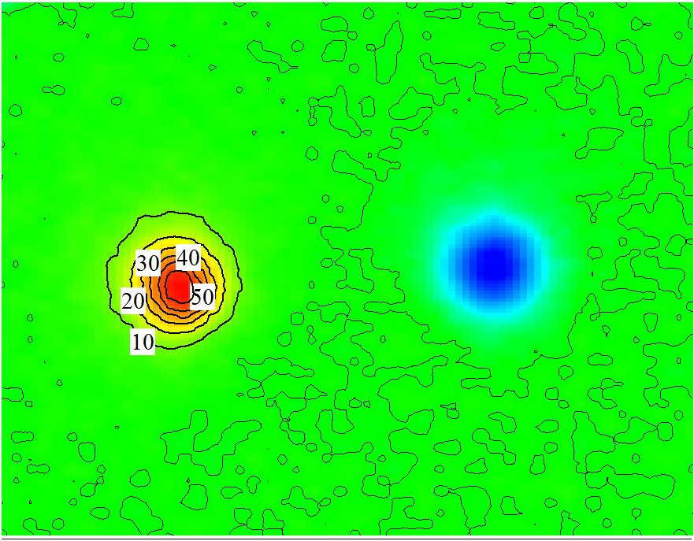
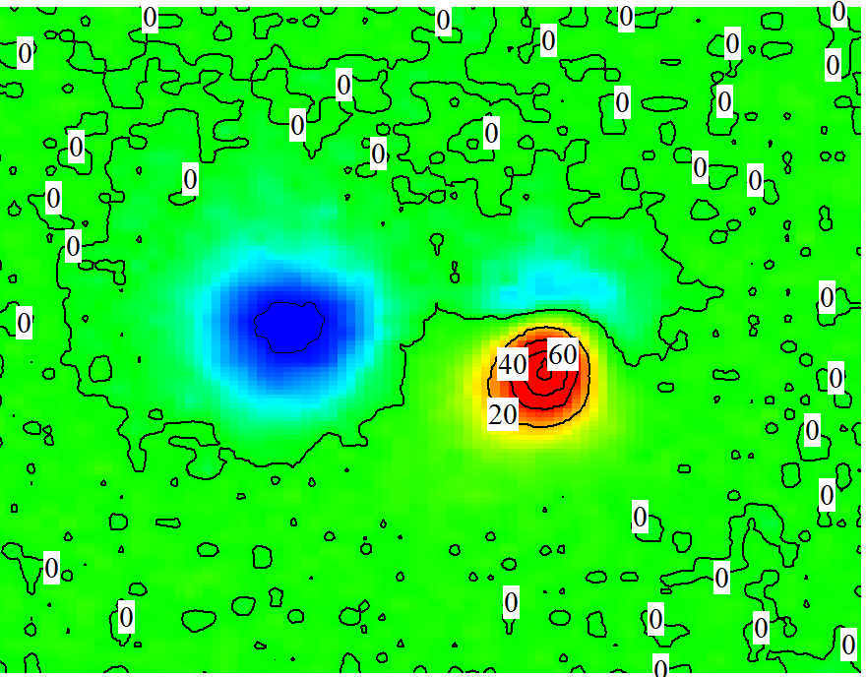
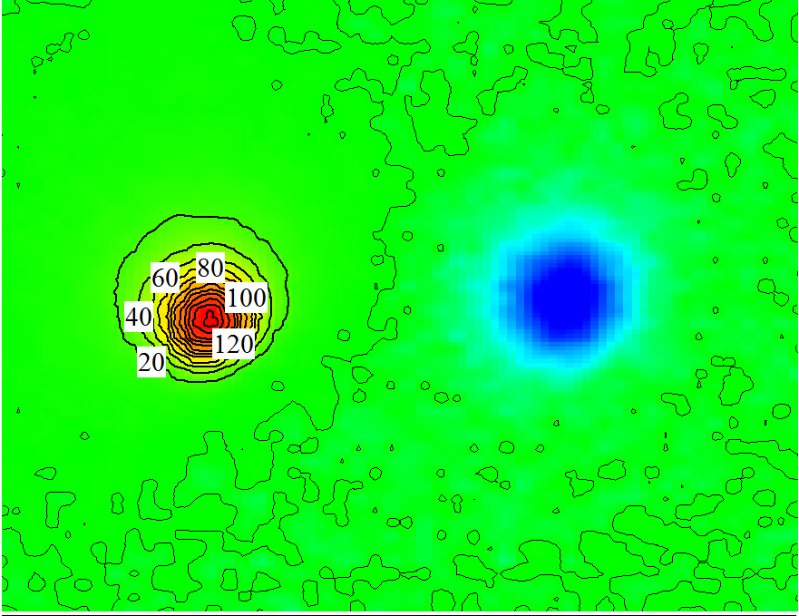
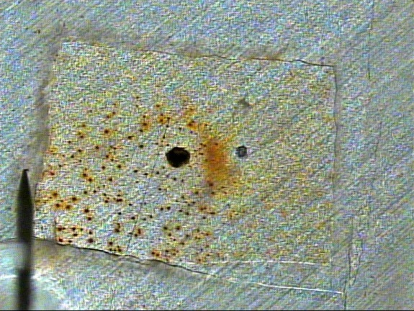
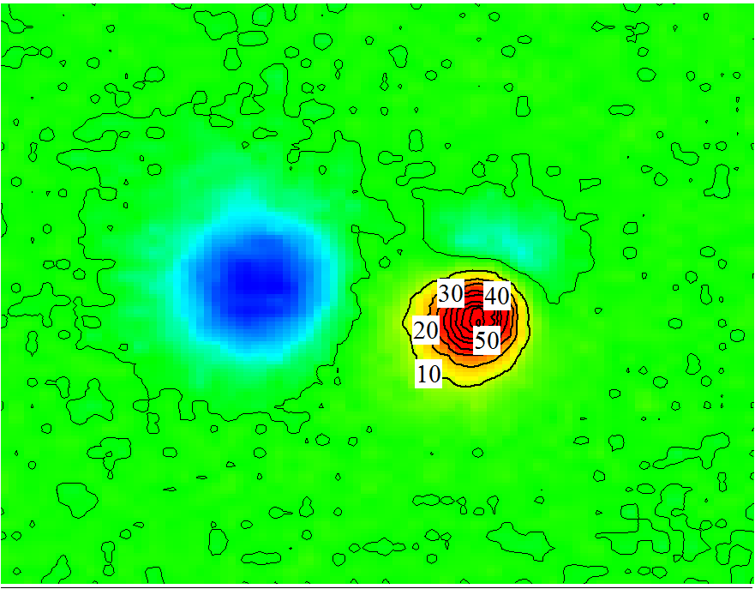
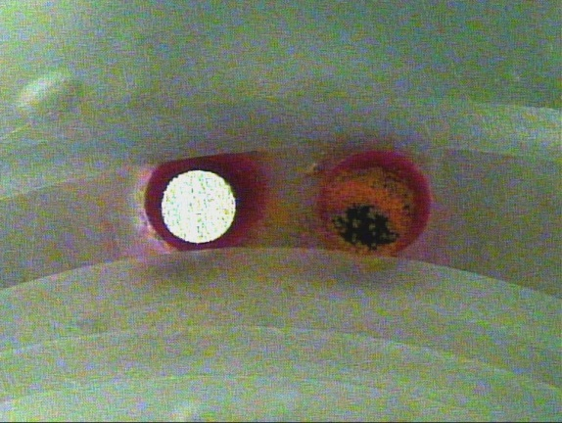
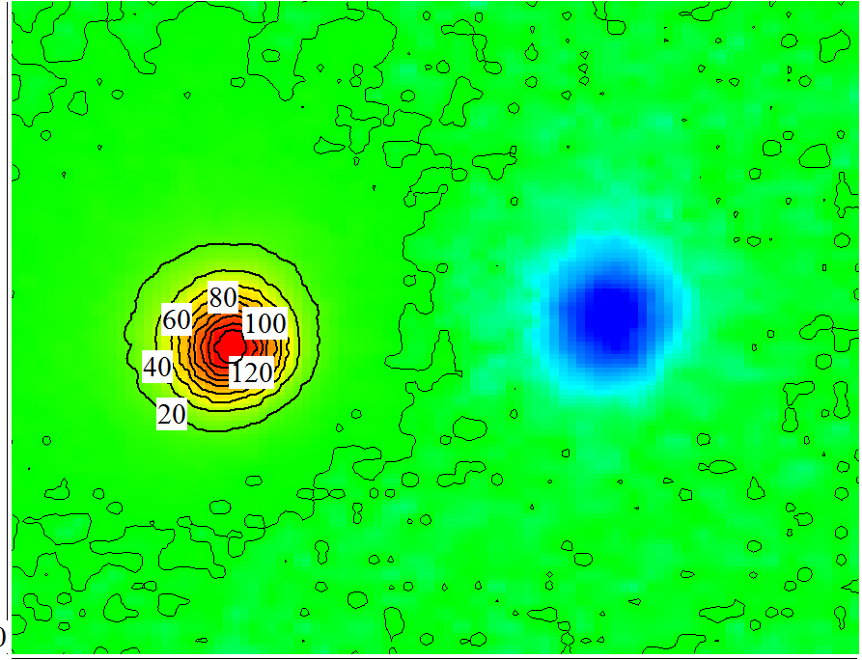
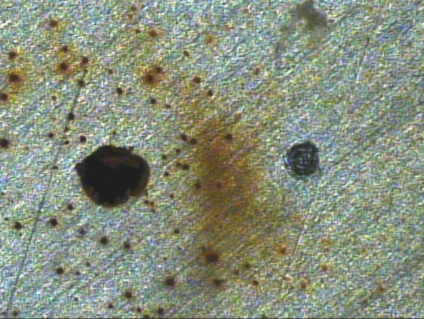
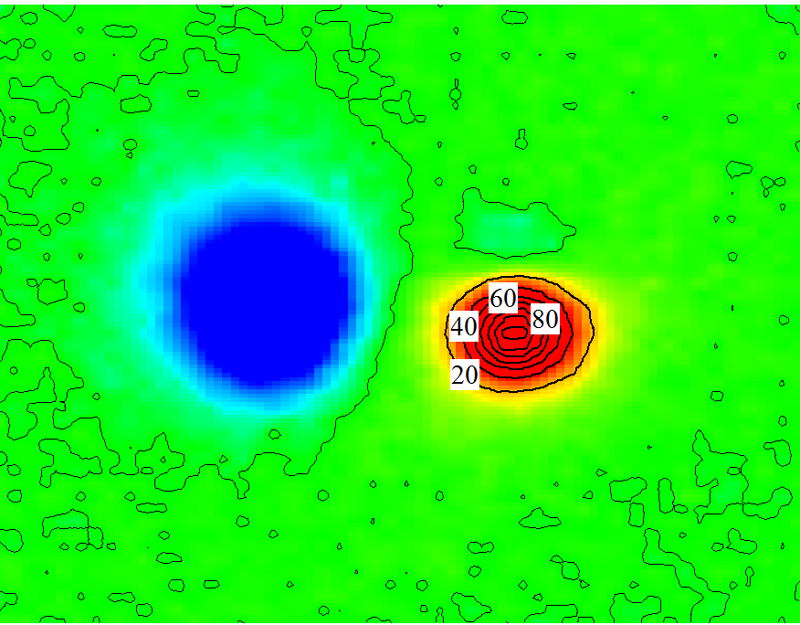
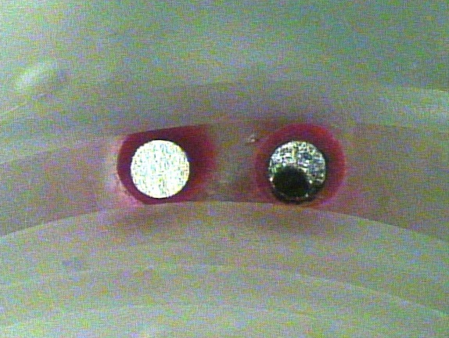
“Pure” Fe
Min
Min
500 μm
250 μm
1h
1h
6h
6h
12h
12h

Slide 11
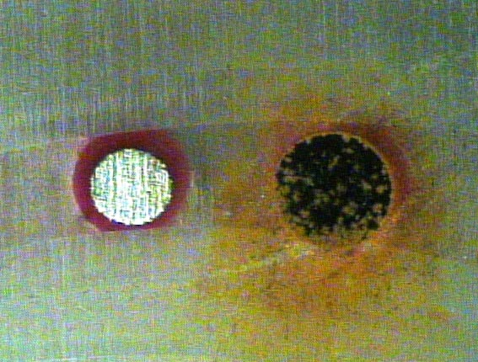
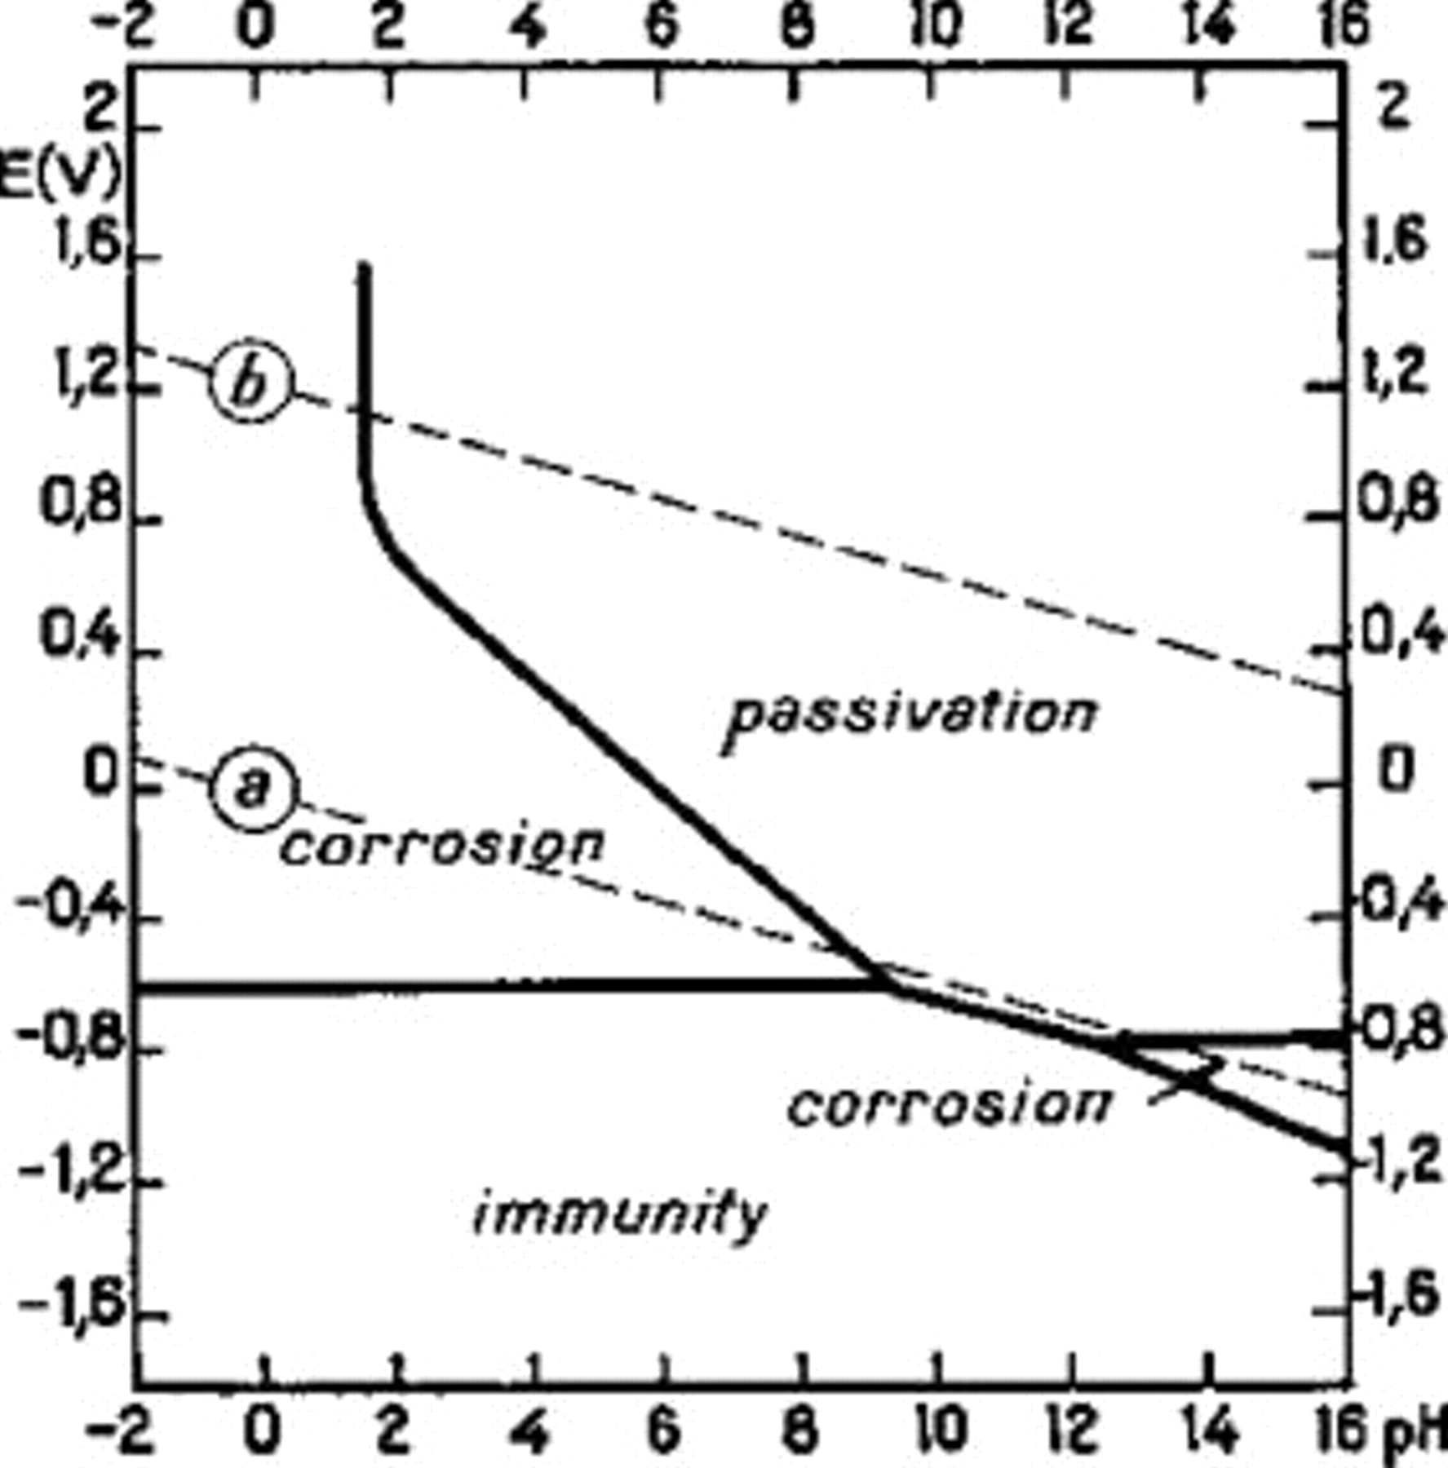
Fe twin electrodes
Current flowing between Fe-Fe (ZRA)
pH and dissolved O₂
above both Fe
Cathodic control
O₂ reduction at the non corroded Fe
250 μm
For a 1mm Fe-Fe
n =4 (2-4)
F = 96485 C mol⁻¹
D_{O2} = 2.01 x 10⁻⁵ cm² s⁻¹
C_{O2} = (2.4 x 10⁻⁷ mol cm⁻³
A = 7.85 x10⁻³ cm²
δ = 325 µm (132 µm if n=2)
O₂ + 2H₂O + 4e⁻ → 4OH⁻
measurements 50 μm above surface
pH
O₂
“passive” Fe
“corroded” Fe

Slide 12
Fe twin electrodes
What can be expected?
Polarization curves of the twin Fe electrodes immediately after breaking the connection
Polarization curves of Fe electrodes in 0.05M NaCl
At pH=6 and pH=10.

Slide 13
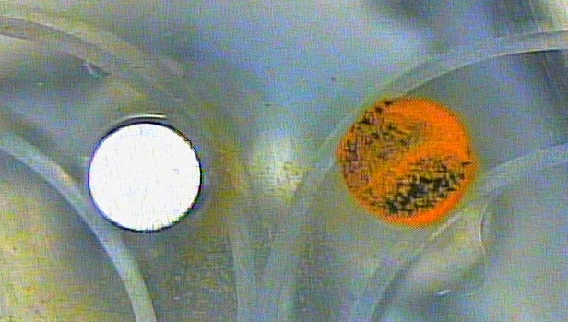
Fe twin electrodes
The polarization curves were repeated with the twin electrodes connected and the current measured with the SVET probe directly above either the “passive” or the “corroded” Fe electrodes.
1 mm

Slide 14
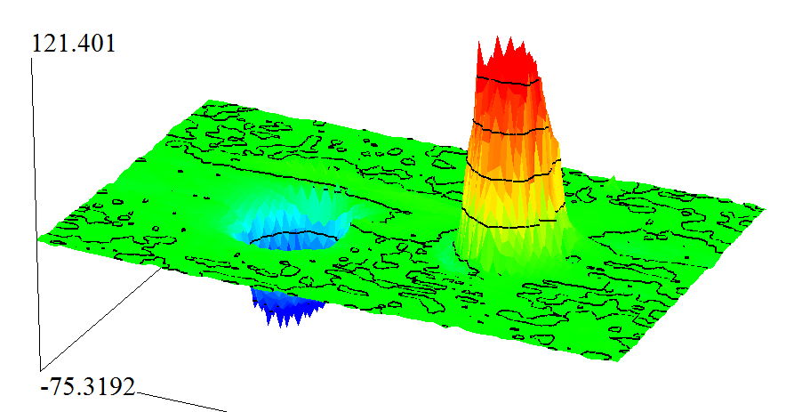





OCP (-0.72 V)
-0.72 V
-0.62 V
-0.5 V
-0.3 V
-0.62 V
-0.3 V
-0.5 V

Slide 15
What do we know so far?
Does it always occur?
For how long does the separation remain?
It is possible to explain how the separation in maintained.
But, what triggers it?

Slide 16










Fe plate
Min
5 mm
30min
1h30
4h30
15h30

Slide 17
Discussion

Slide 18
Other
metals and alloys
Pure Fe, 0.05M NaCl
Other enviroments
pH, NaCl conc.

Slide 19
Critical factors
Pure metal or alloy?
Phases, intermetallics, precipitates, impurities, surface preparation, temperature gradients, crystal vibrations.
Heterogeneities
Solution: compositional variations (O₂, Cl⁻, other conc.), conductivity, temperature gradients, convective fluxes, vibrations.
Solution composition
Conductivity
pH
Passivity
Time
Geometry (size and distances)
What if more defects?
Evans
Agar
Hoar
Akimov
Tomashov
Wagner number analysis
L = κ R_{p}
1x1 mm²
1x1 cm²
1x1 dm²
1x1 m²

Slide 20

Same metal/alloy
Different environment (pH)
10⁻² M Cl⁻
M. Pourbaix, Lições de Corrosão Electroquímica, Lisboa, 1986.

Slide 21

Different metals
NEUTRAL
CONDITIONS
Mg
Fe
Fe
Cu
H. Kaesche, Corrosion of metals, Springer-Verlag, 2005.

Slide 22

Effect of distance
N.D. Tomashov, Theory of Corrosion and Protection of Metals, Macmillan, 1966.

Slide 23










Other metals
Coatings and deffects
Pure Zinc
AZ31
1 hour
minutes
500 μm
1 mm
12 hours
30 min
20 hours

Slide 24














Other metals
Twin wires
Zinc
polished
AA2024
Mg
mins
mins
1 mm
1 hour
1 hour
30 min
18 hours
17 hours
2h
13 hours

Slide 25















Other metals
Plates
Zinc
AA2024
polished
AA2024
etched
Mg
1 h
4 h
4 h
5 mm
6 h
min
12 h
12 h
24 h
30 min
5 mm
5 mm
1 h
5 mm

Slide 26
Conclusions
The anode/cathode separation is explained by the different local pH which maintains one electrode active while the other becomes passive.
Still not clear is what provokes the pH separation at the beginning of immersion.
There is a critical distance beyond which this effect ceases. Which distance and the parameters that control it remain unidentified.

Slide 27


Acknowledgements
M.C. Quevedo thanks CONACYT (Mexico) for the post doc scholarship approach nº 203529 and A.C.Bastos thanks a post-doc grant with the reference BPD/UI50/2739/2013. Funds from Fundação para a Ciência e a Tecnologia (Portugal) project PTDC/CTM-MAT/1515/2012 are also acknowledged.

Slide 28

Dimensional causes of discrepances
Same current density
Change conductivity
accordingly
Conc. O2

Slide 29


Wagner number
(L)
Wagner Length
Wagner Parameter
Polarization Parameter
$$L= σ Rp= σ\frac{dE}{di}={\left(ρ\frac{di}{dE}\right)}^{−1}$$
$$\frac{l}{L}=\frac{characteristic length of the system}{Wagner length}$$
Wagner Number (W)
In scalling, the Wagner number must be kept constant
Current varies significantly over
The surface of the electrode
Large value (W)
→
Macroscopic
behaviour
→
→
Localized corrosion
Waber
Microscopic
behaviour
Small variation in current density at electrode surface
Small value
→
→
→
Uniform corrosion

