Slide 1

Electrochemical Techniques in Materials Science and Engineering
A.C. Bastos
acbastos@ua.pt

Slide 2
Objective
Short illustration on how electrochemical techniques can be used to characterise novel materials and help identify new functions and applications.
Contents
- A glimpse of electrochemistry
- Applications in science and technology
- Examples of the use of electrochemical techniques in
the research and development of new materials:
- Cyclic Voltammetry
- Electrochemical Impedance Spectroscopy (EIS)
- Microelectrodes

Slide 3
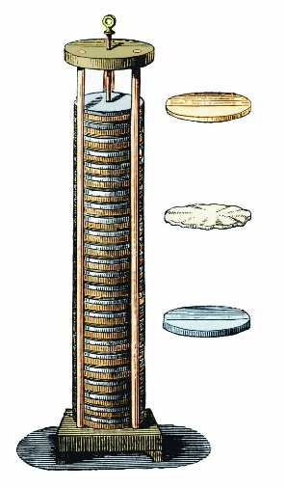
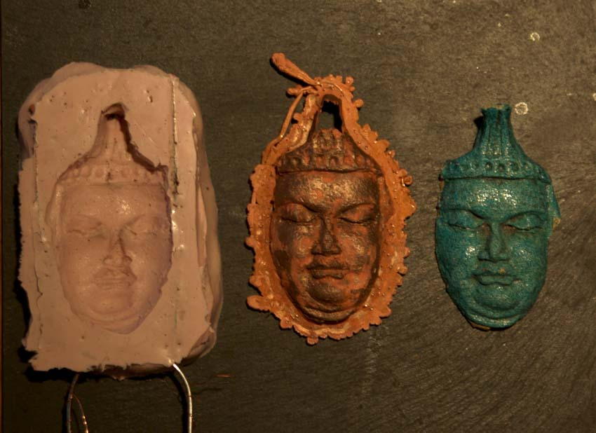
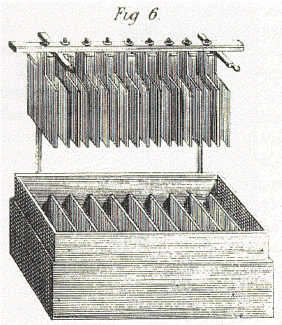
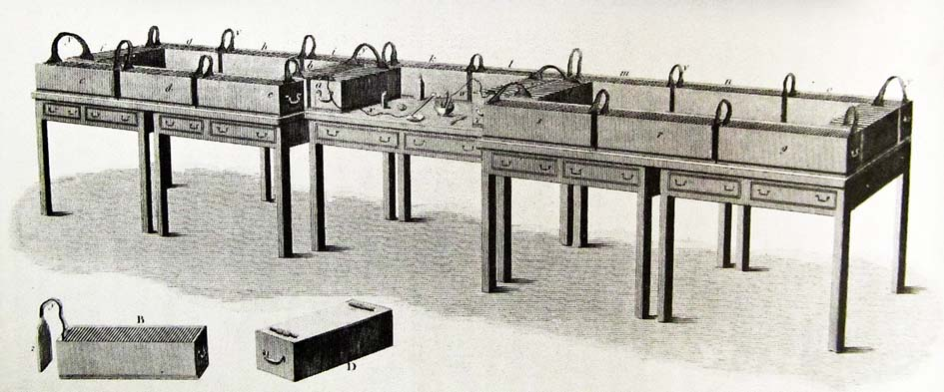
Electrochemistry
Electrochemistry studies the chemical phenomena involving electricity.
Historically it is considered to have begun in 1800 with the Alessandro Volta pile.
Applications evolved fast.
1800 Water electrolysis (Nicholson and Carlisle, England; Ritter in Poland).
1802/4 In England, Wollaston discovers Pa and Ro, Tennant discovers Ir and Os.
1805 Luigi Brugnatelli (Italy) invents electrodeposition (deposited gold).
1807/8 Humphry Davy (England) discovers Li, K, Na, Ca, Mg by electrolysis of
molten salts with a battery with 2000 elements.
1838 Jacobi (Germany) invents galvanoplasty (electrotyping).

Slide 4
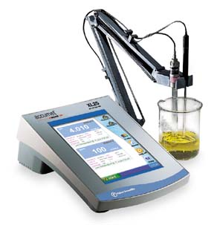
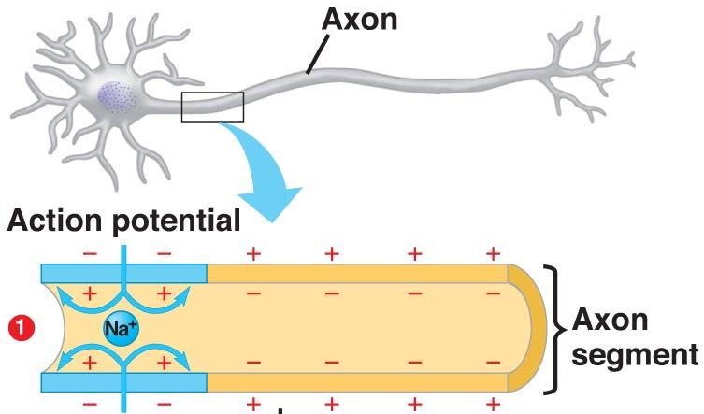
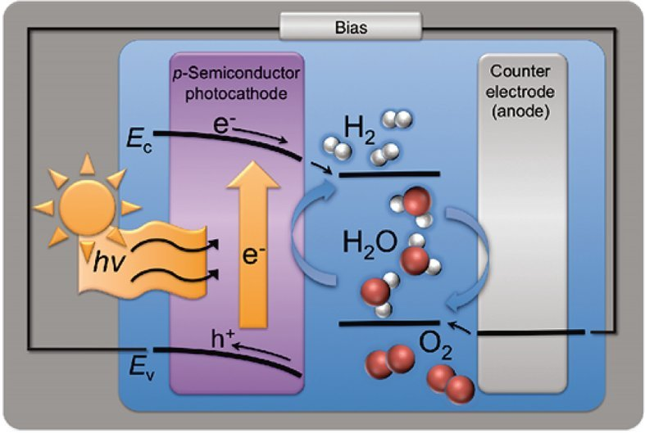
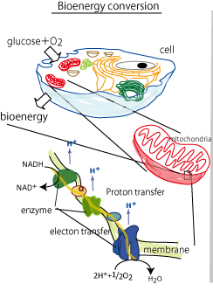
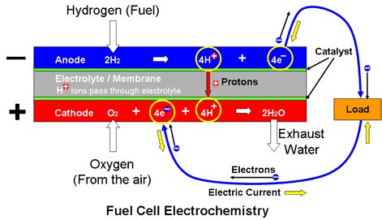
Electrochemistry today
Analytical
Chemistry
Industry
- Refining of metals
- Electrosynthesis
- Surface treatments
- Corrosion protection
Life sciences
Environment
- Soil decontamination
- CO₂ valorisation
- Water treatment
- Elimination of pollutants
Energy
- Batteries
- Accumulators
- Fuel cells
- Solar cells
- Supercapacitors

Slide 5
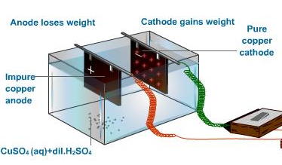
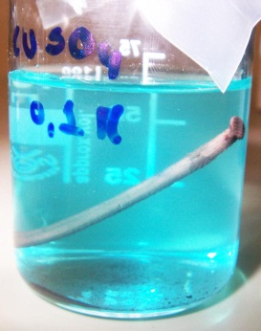
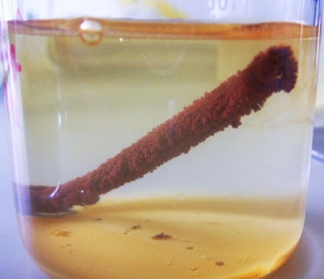
Electrochemistry
Reduction-oxidation reactions (redox reactions) are chemical reactions where one species looses electrons (oxidizes) and another species gains electrons ( iis reduced). The half-
-reactions (oxidation and reduction) can occur separated in space.
Overall reaction: Ox₁ + Red₂ ⇔ Red₁ + Ox₂
Example: Cu²⁺ + Fe ⇔ Fe²⁺ + Cu
Reduction (cathode): Ox₁ + ne⁻ ⇔ Red₁
Red: Cu²⁺ + 2e⁻ ⇔ Cu
Oxidation (anode): Red₂ ⇔ Ox₂+ ne⁻
Ox: Fe ⇔ Fe²⁺ + 2e⁻
Spontaneous (galvanic) process
With a power source
(electrolytic process)

Slide 6
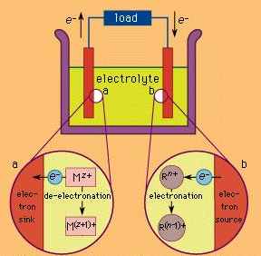
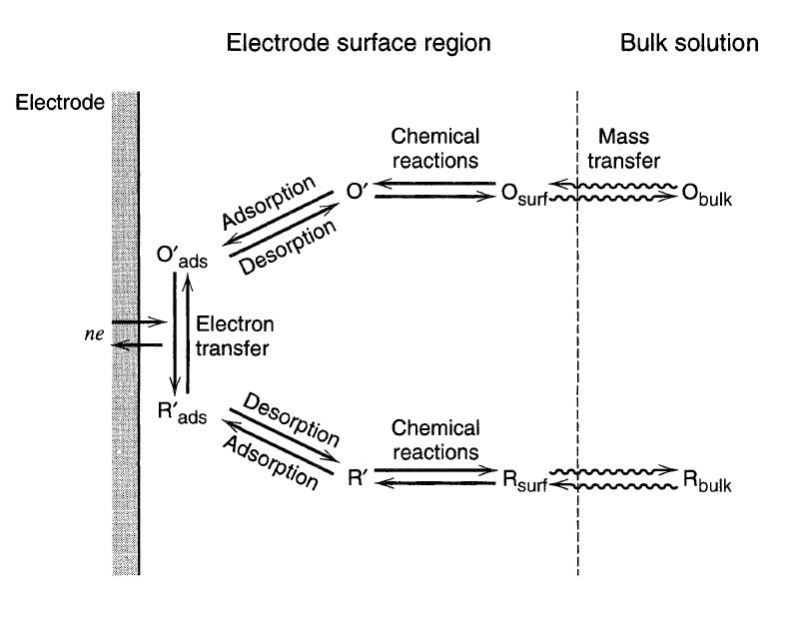
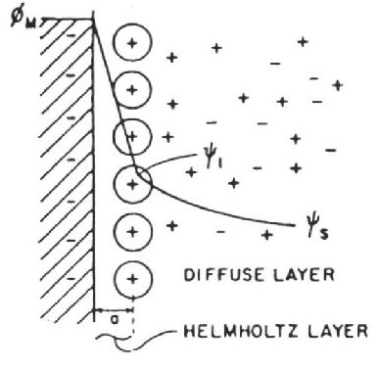
Charge transfer
Faradaic current
Electrical double layer
Equivalent electric circuit
Capacitive current

Slide 7
Electrochemistry
Key quantities
Electrode potential, E (V_{vs reference})
Electrical current, I (A)
Current density, i (A m⁻²)
Charge, Q (C)
Time, t (s)
Current is a RATE:
Current density is more important:
Charge is an AMOUNT:

Slide 8
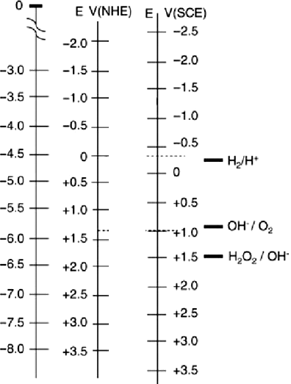
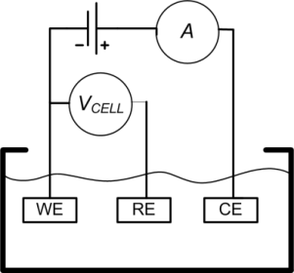
Electrochemistry
Electrode Potential scales
3 electrode cell

Slide 9
We have a new material.
Now what?
Electro-
-synthesis
Environment
Removal
of pollutants
C a t a l y s t
New
material
Electrochem. properties
ORR
OER
Fuel cells
Conductive?
Reversible?
Potential window?
Energy
Supercaps
Sensors
ORR - oxygen reduction reaction
OER - oxygen evolution reaction
Supercaps - supercapacitors

Slide 10
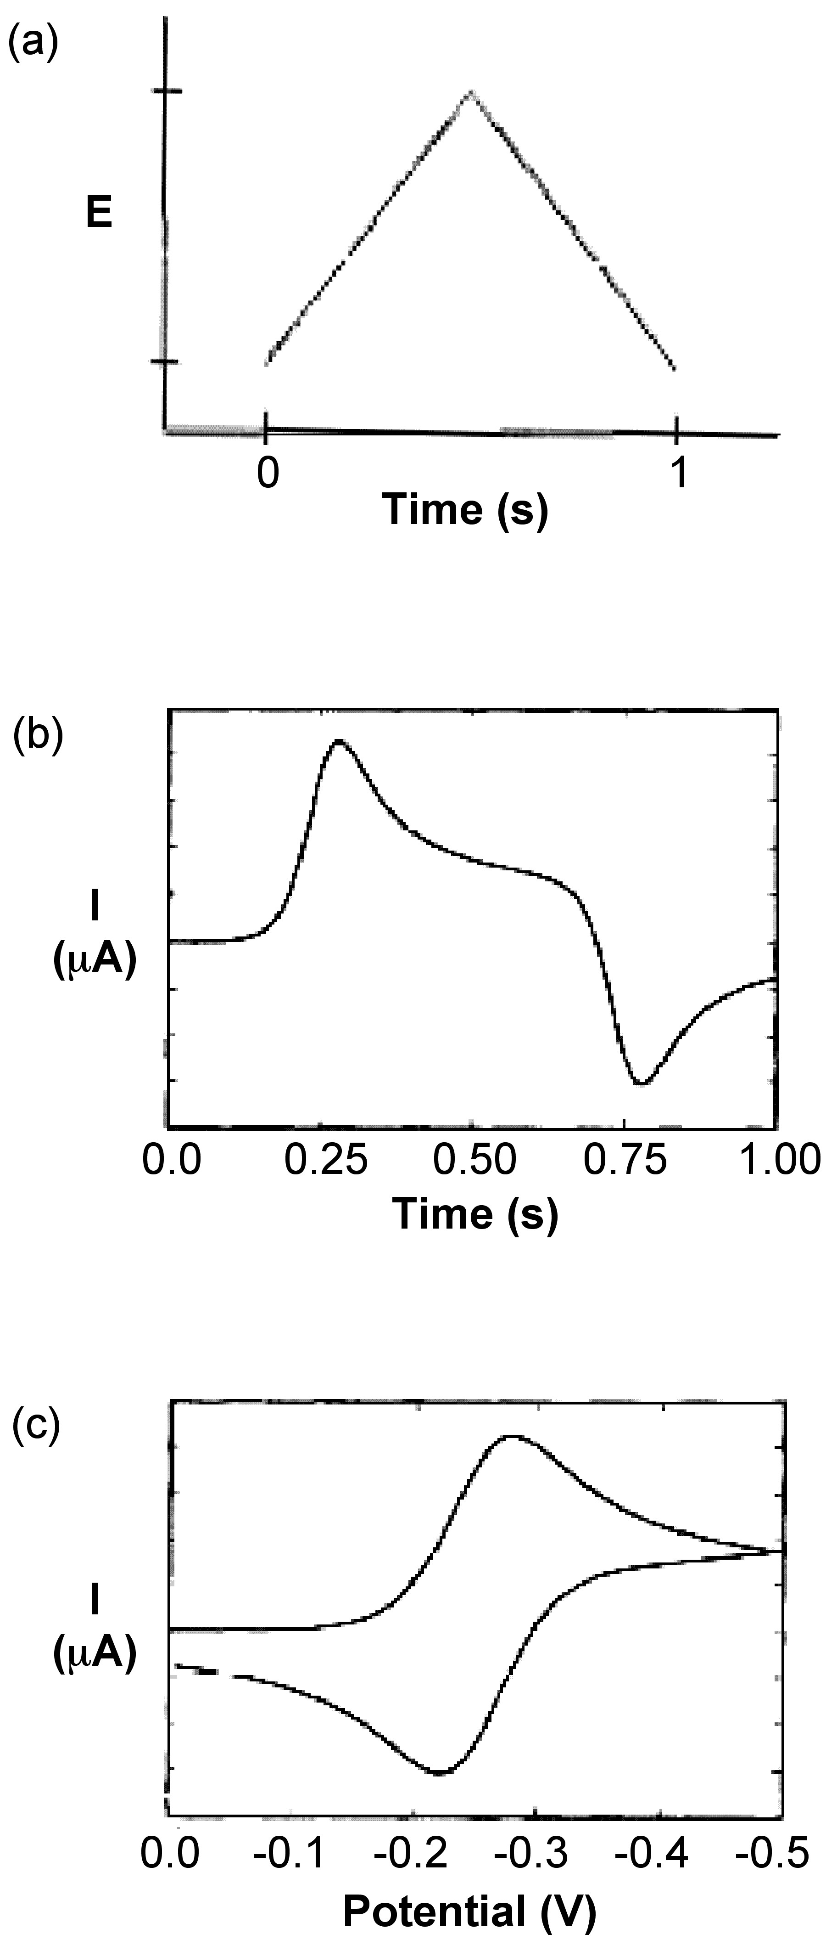
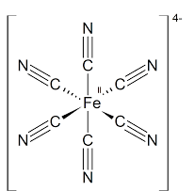
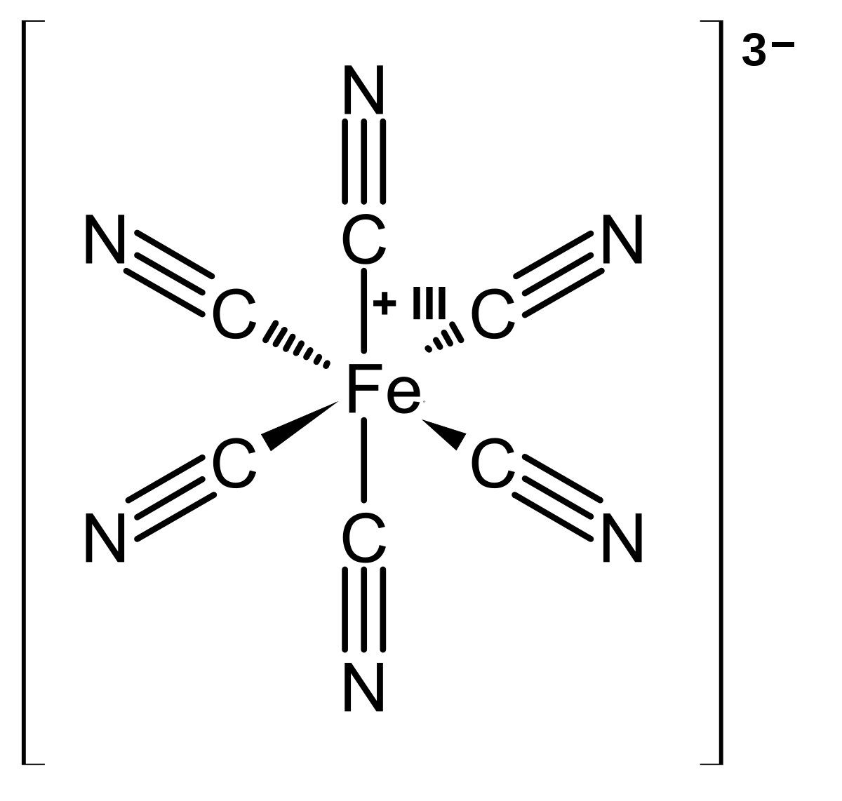
Cyclic voltammetry
Hexacyanoferrate(II)
Hexacyanoferrate(III)
Reversible vs irreversible

Slide 11
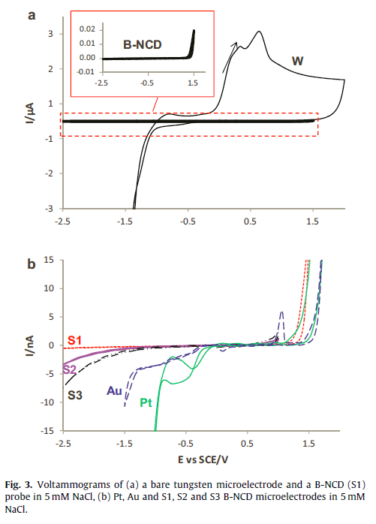
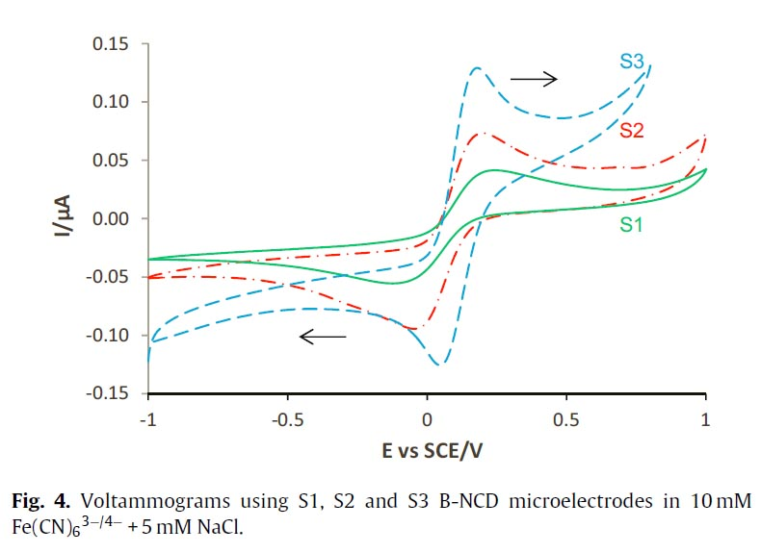
1. Conductivity (using a simple DMM)
3. Working potential window
Good? Acceptable?
2. Check electrochemical response.
Good? Acceptable?
Electrochim. Acta 76 (2012) 487

Slide 12
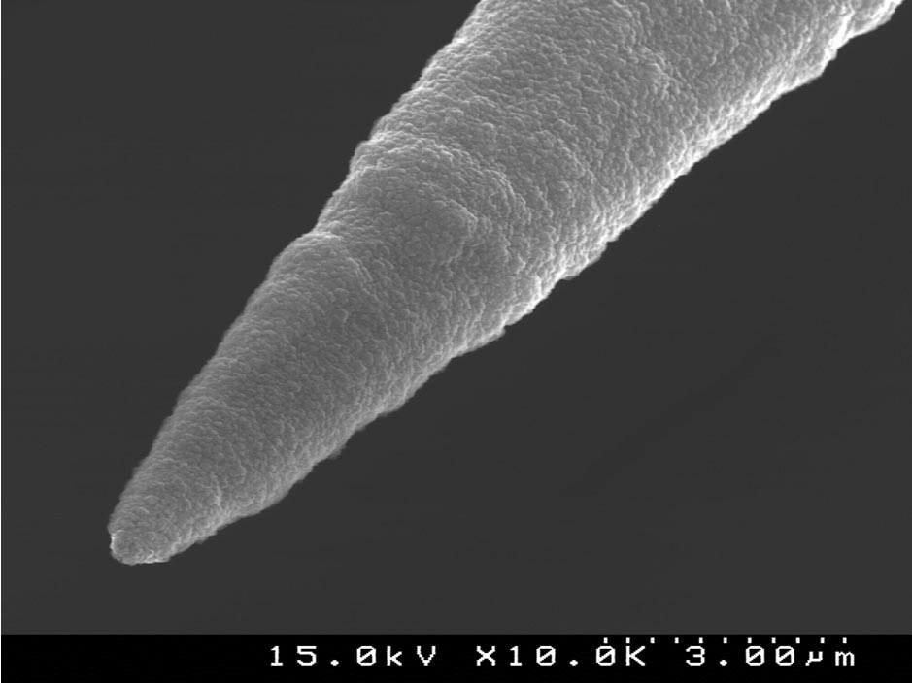
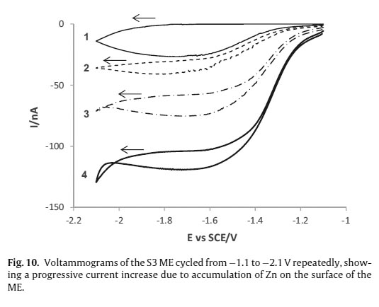
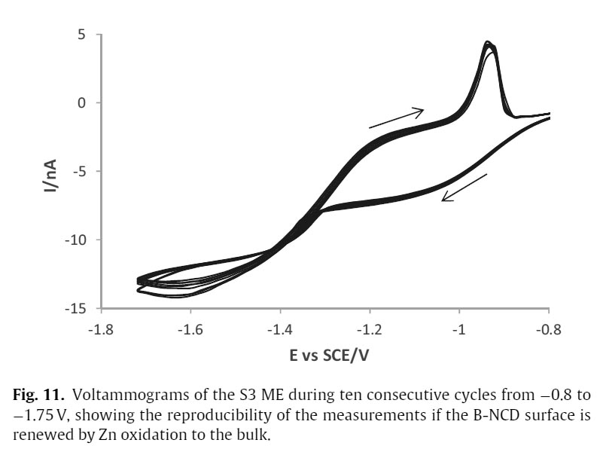
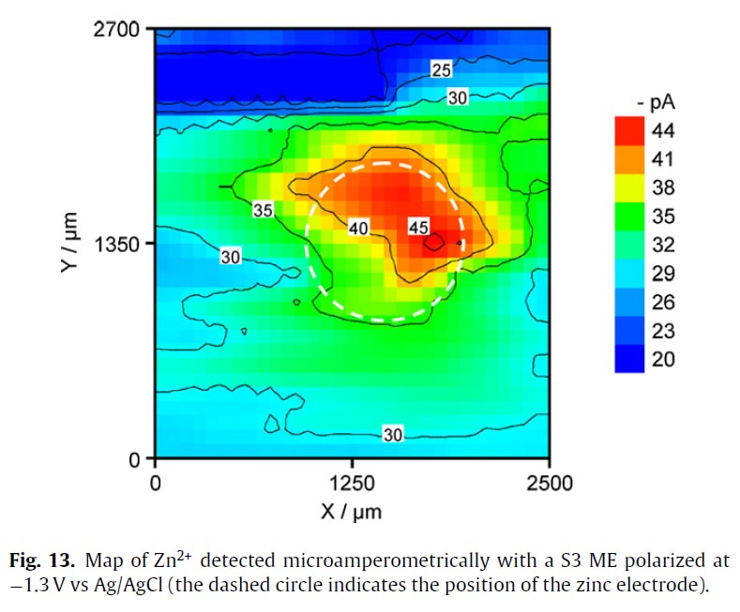
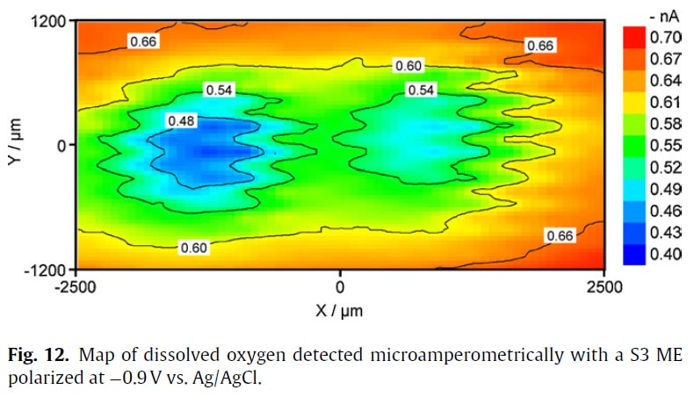
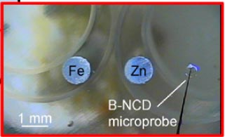
Boron doped diamond (BDD) microelectrodes
for detection of Zn²⁺ and O₂ in water
Electrochim. Acta 76 (2012) 487
Detection of Zn²⁺
Detection of dissolved O₂
Fe-Zn galvanic cell
Another application for this material:
oxidation of pollutants dissolved in water (electrodes with large area)

Slide 13
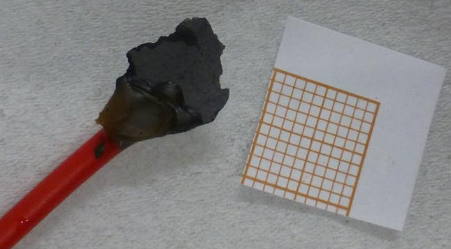
Reduced graphene oxide on paper substrate
Not good catalysts…
…but maybe still OK as materials for supercapacitors or potentiometric sensors.

Slide 14
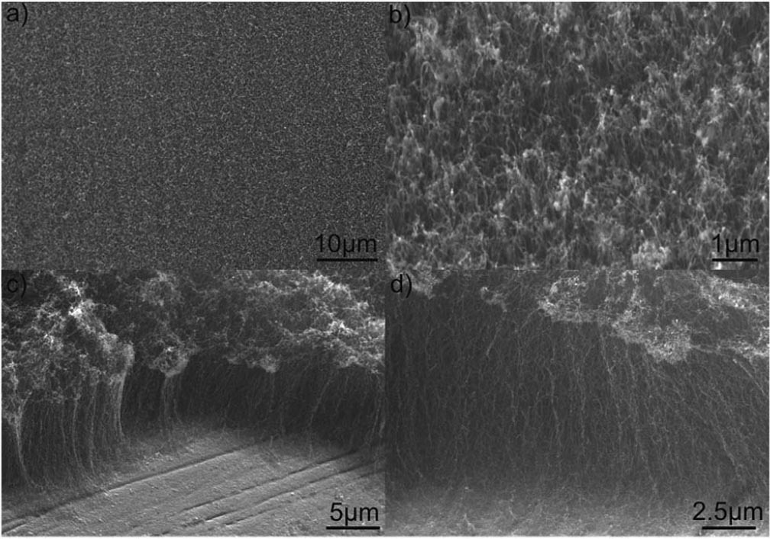
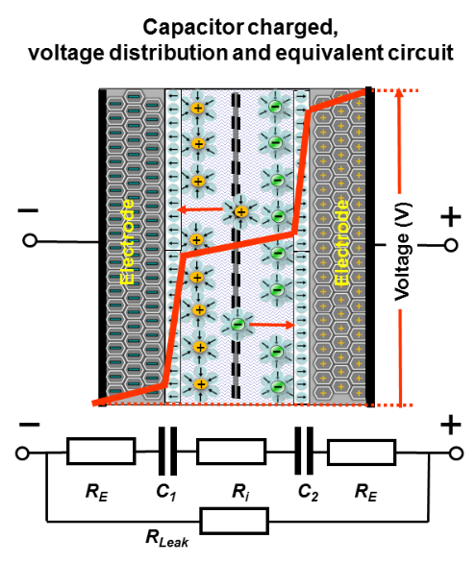
Vertically aligned carbon nanotubes (VACNTs) grown directly on pretreated Inconel® metallic substrate by thermal CVD
J Mater Chem A 3(2015)17804
Supercapacitors

Slide 15
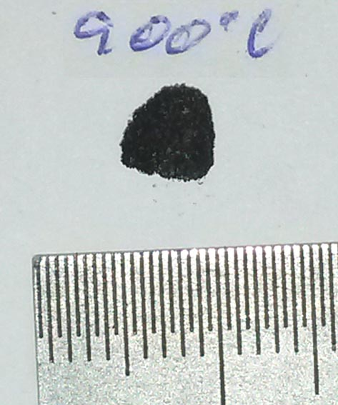
Calcined PU foams
- High resistance
(increasing calcination temperature decreases
the resistance but then brittleness increases).
- Bad cyclic voltammograms
(irreversible response)
Potentiometric response to pH
Linear response to pH but slope is
33-37 mV/pH unit where it should be 59 mV/pH unit

Slide 16
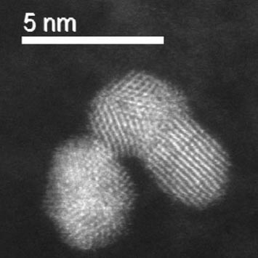
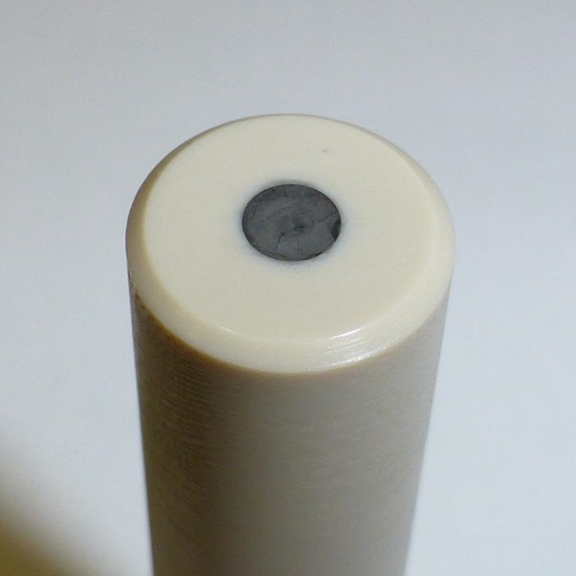
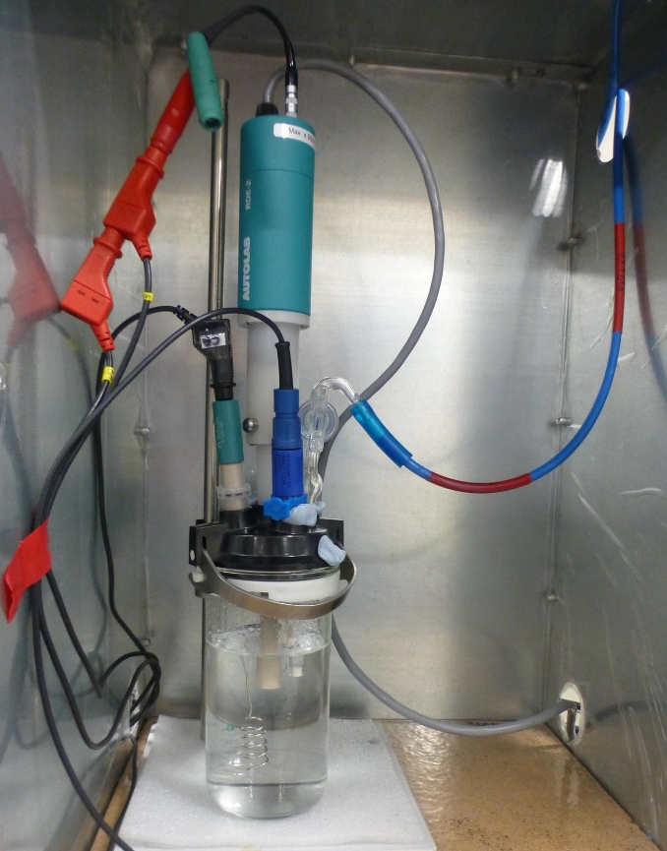
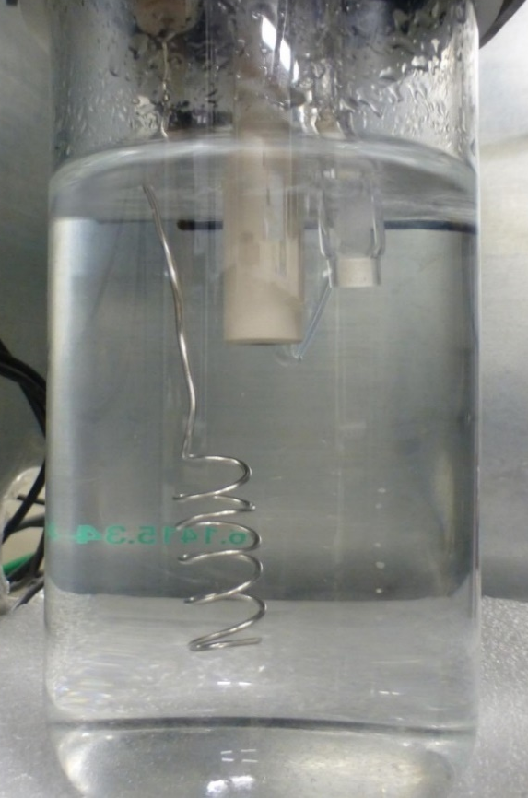
CoPt3 Nanoparticles
GC disk with a dried drop of the dispersion.
    2 µL suspension
    (4 ng of NP)
    +
    2 µL of Nafion 0.05 wt.% in ethanol
RDE motor
WE
(RDE)
RE
Working electrode (WE):
NPs on GC RDE.
Reference Electrode (RE):
Hg|Hg₂SO₄|K₂SO₄(sat)
(E = +0.651V_{RHE}; E = +0.409V_{SCE})
Counter Electrode (CE):
Platinum wire
Electrolyte:
0.5M H₂SO₄
Bubbling of gas:
Argon or O₂
CE
RE
Gas inflow
Gas bubbling
CE
0.5M H₂SO₄

Slide 17
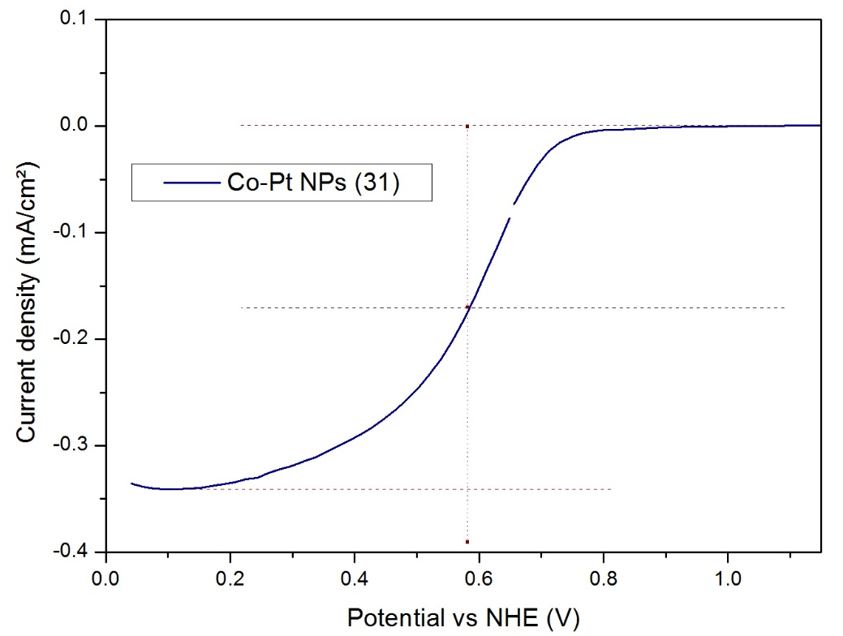
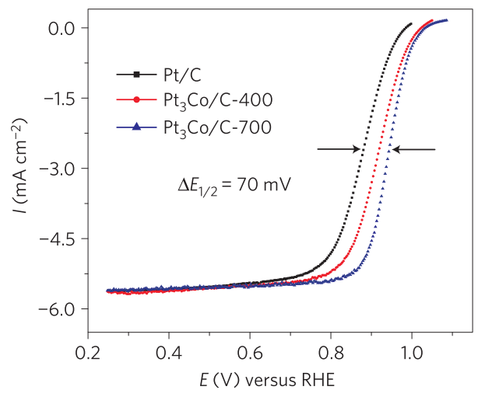
Cyclic voltammetry with O₂ in solution (saturation)
Nature Materials 12 (2012) 81.
5 mV/s in O₂ saturated 0.5M H₂SO₄
at room temperature and 1600 rpm.
5 mV/s in O₂ saturated 0.1 M HClO₄
at toom temperature and 1600 rpm.

Slide 18
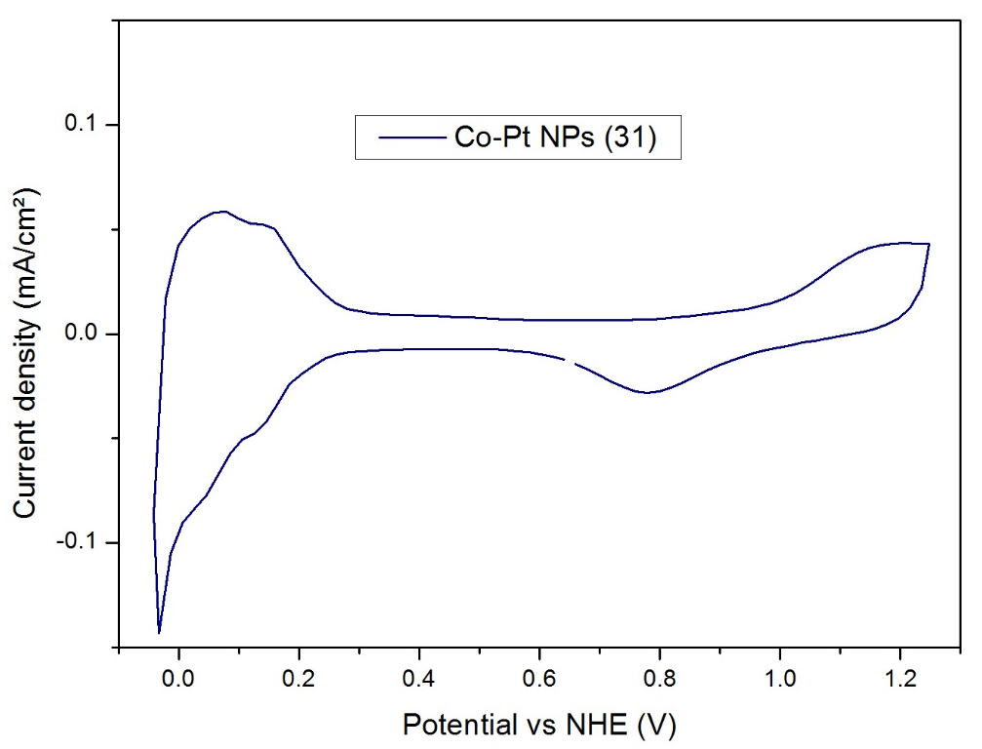
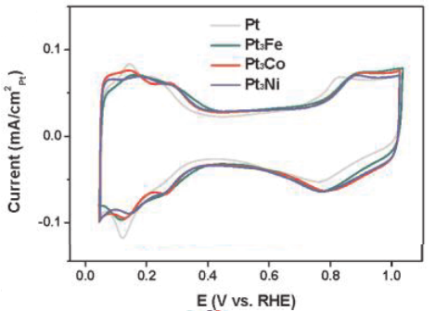
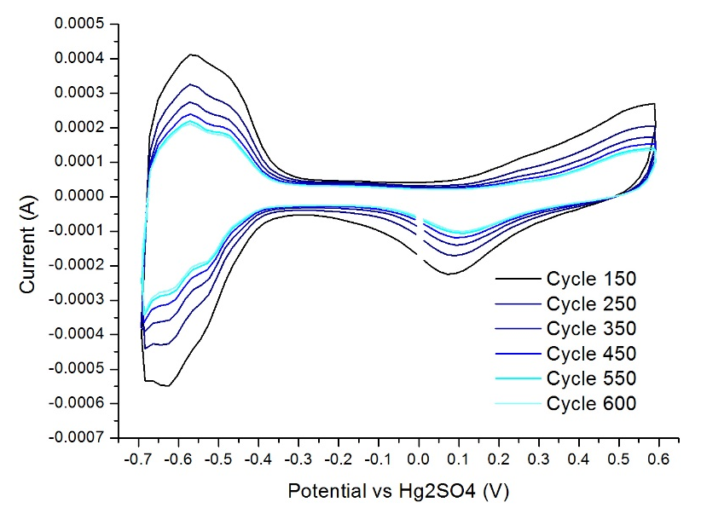
Cyclic voltammetry without O₂ in solution (Ar bubbling)
ACS Catalysis 1 (2011) 1355.
~100 mV
~350 mV
50mV/s in Ar saturated 0.5M H₂SO₄
at room temperature and 1600 rpm.
50 mV/s in Ar saturated 0.1 M HClO₄
at 60 °C and 1600 rpm.
Decrease in current: poisoning or surface deactivation.

Slide 19
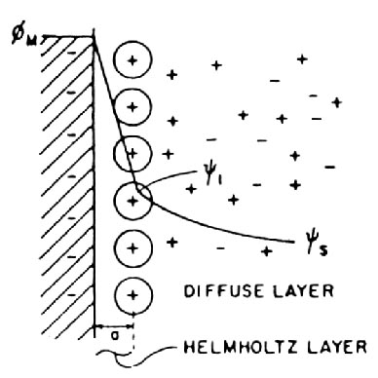
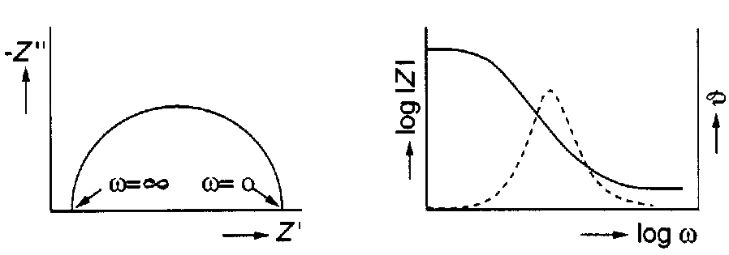
Electrochemical Impedance Spectroscopy (EIS)
The simplest representation of the electrode-solution interface
Electrical double layer
ω = 2π f
Bode plot
log |Z| vs log f
θ vs log f
Nyquist plot
Electron transfer
-Z”vs Z’
θ-
f

Slide 20
Impedance of a painted metal
while it degrades
R_{s}
1. Intact film
paint
C_{f}
metal
R_{s}
R_{ct}
C_{dl}
2. Conductive pathways through the film
C_{f}
R_{po}
R_{po}
C_{f}
R_{s}
R_{po}
3. corrosion
C_{f}
C_{dl}
R_{ct}
R_{s} – solution resistance
R_{po} – paint (pore) resistance
C_{f} – paint film capacitance
R_{ct} – charge transfer resistance
C_{dl} – double layer capacitance

Slide 21
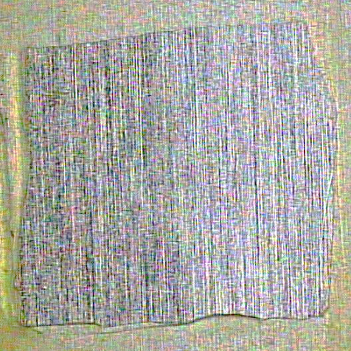
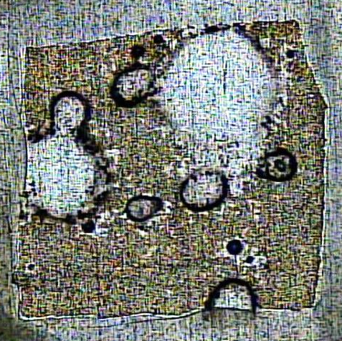
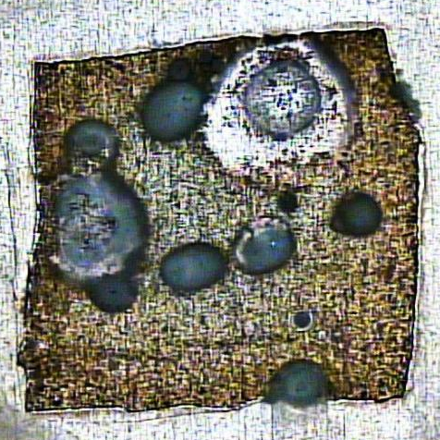
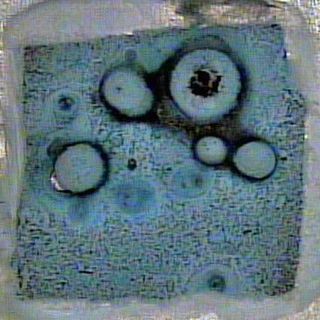
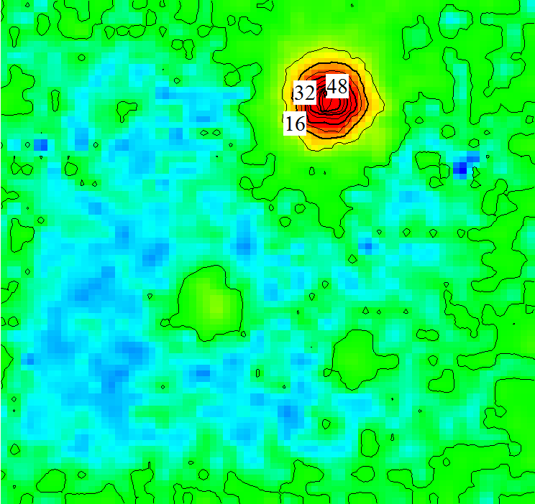
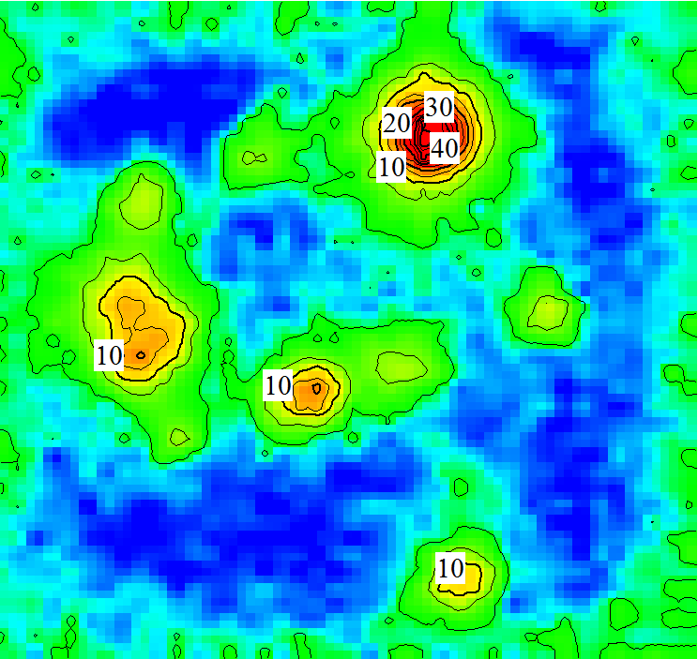
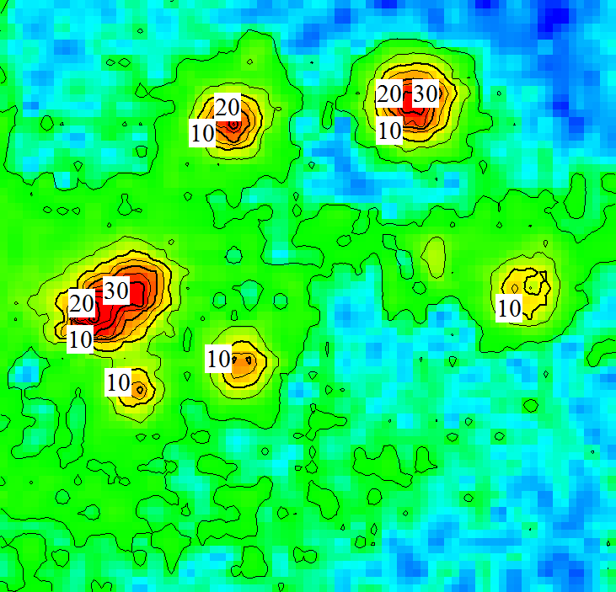


Impedance of aluminium alloy 2024-T3 immersed in 0.05M NaCl
EIS
30 min
1 day
1 week
1 month
1 mm
μA cm⁻²

Slide 22
Microelectrodes
- Can probe small volumes of solution
- Provide spatial resolution
- Can be placed very close to the surface
SRET – Scanning Reference Electrode Technique
SVET – Scanning Vibrating Electrode Technique
LEIS – Localised Electrochemical Impedance Spectroscopy
SIET – Scanning Ion Selective Electrode Technique
SECM – Scanning Electrochemical Microscopy
WBE – Wire Beam Electrode
SKP – Scanning Kelvin Probe
SKPFM – Scanning Kelvin Probe Force Microscopy
AFM – Atomic Force Microscopy

Slide 23



Scanning Vibrating Electrode Technique
(SVET)
10 μm
probe
vibrating

Slide 24


Electrogalvanised steel 1 day in 0.05M NaCl
1 mm

Slide 25

Electrogalvanised steel 1 day in 0.05M NaCl

Slide 26

DC04 low carbon steel in 0.05 M NaCl

Slide 28



Micro-potentiometry (SIET)
Ion- Selective Microelectrodes
Ref. electrode
Ag wire with AgCl coat
glass micropipette
1 cm
Filling solution:
0.005M NaCl
sensitive ionophore gel
76 µm

Slide 29



Etched AA2024-T3 after 24 houras in 0.005 M NaCl
1 cm
pH map
pH
Pits
1 mm

Slide 30
Degradation (corrosion) of bioglass in SBF solution
Ca²⁺
Na⁺
Mg²⁺
pH
z
Flux (mol s⁻¹ m⁻²)
y
Work ongoing
x

Slide 31
Water splitting in TiO₂ nanotubes
investigated with microelectrode techniques
Oxidation
OH⁻
Redution
H₂O + 2h⁺ → 1/2O₂ + 2H⁺
H⁺
1/2O₂ + H₂O + 2e⁻ → 2OH⁻
2H₂O + 2e⁻ → H₂ + 2OH⁻
e⁻

Slide 32



Water splitting in TiO₂ nanotubes
investigated with microelectrode techniques
TiO₂ nanotubes
Irradiated spot
UV LED (365 nm)
< 5 mW cm⁻²
0.1M Na₂SO₄
1 mm
SVET map before irradiation
(no current)
SVET map during irradiation
(anodic spot, remaining area slightly cathodic)
μA cm⁻²
μA cm⁻²

Slide 33
Water splitting in TiO₂ nanotubes
investigated with microelectrode techniques
Side view
Top view
0.05M Na₂SO₄
UV
SVET
Masking
wax
Adhesive
tape
Epoxy mount
Short-circuit
Bright side
Dark side
Potentiostat
SIET

Slide 34
Conclusions

Slide 35
Presentation template by SlidesCarnival (www.slidescarnival.com)

